Slide 1
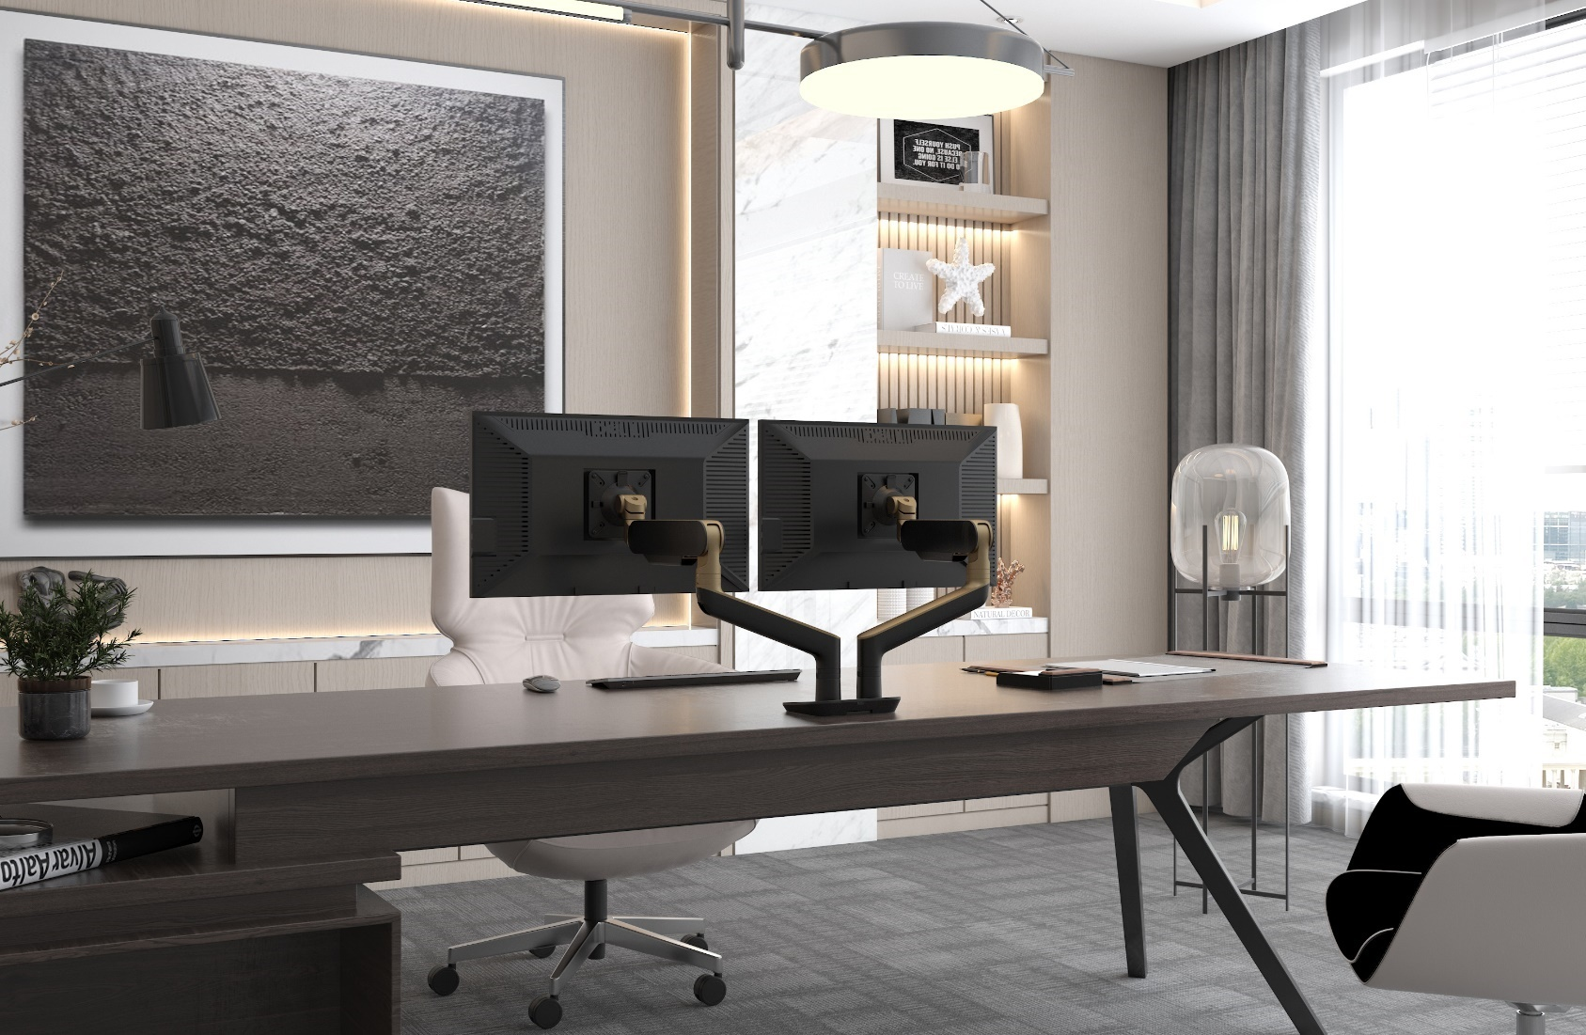

Design Package

Slide 2
Dealer: Contact: Customer: Opportunity Name: Opportunity Number: Date: Designer:
x x x x x x x

Slide 3
FLOORPLAN

Slide 4
TYPICAL LEGEND
(AREA OF WORK)
*GENERIC FURNITURE PLAN FOR REFERENCE ONLY; NOT TO SCALE
FLOORPLAN

Slide 5
ISOMETRIC

Slide 6
RENDERING

Slide 7
FURNITURE PLAN VIEW
RAILWAY PLAN VIEW
Base In-Feed; Located At Any End Post
RAILWAY TYPICAL LAYOUT

Slide 8
Example-Adjust as needed
6-Pack Pre-Configured Linear Railway, 60”W x 18”H Double-Sided Power Beams, Each User To Receive 2-Duplex Receptacles (Circuits #1 & #2) & 2-Data Openings, 6’L Hardwired Base In-Feed Power (Located At Any End Post)
60”W x 30”D Rectangular Worksurface; Thermally-Fused Laminate
Triumph-LX 2-Leg, 2-Stage, Electric Height Adjustable Base
58”W x 25”H Centro Privacy/Modesty Screen
EPPA2 Dual Monitor Arm
FLEXCHARGE3 Desktop Power Module
Trough Under Surface Cable Manager
Conceal Vertical Cable Manager
RAILWAY TYPICAL LAYOUT

Slide 9
TYPICAL

Slide 10
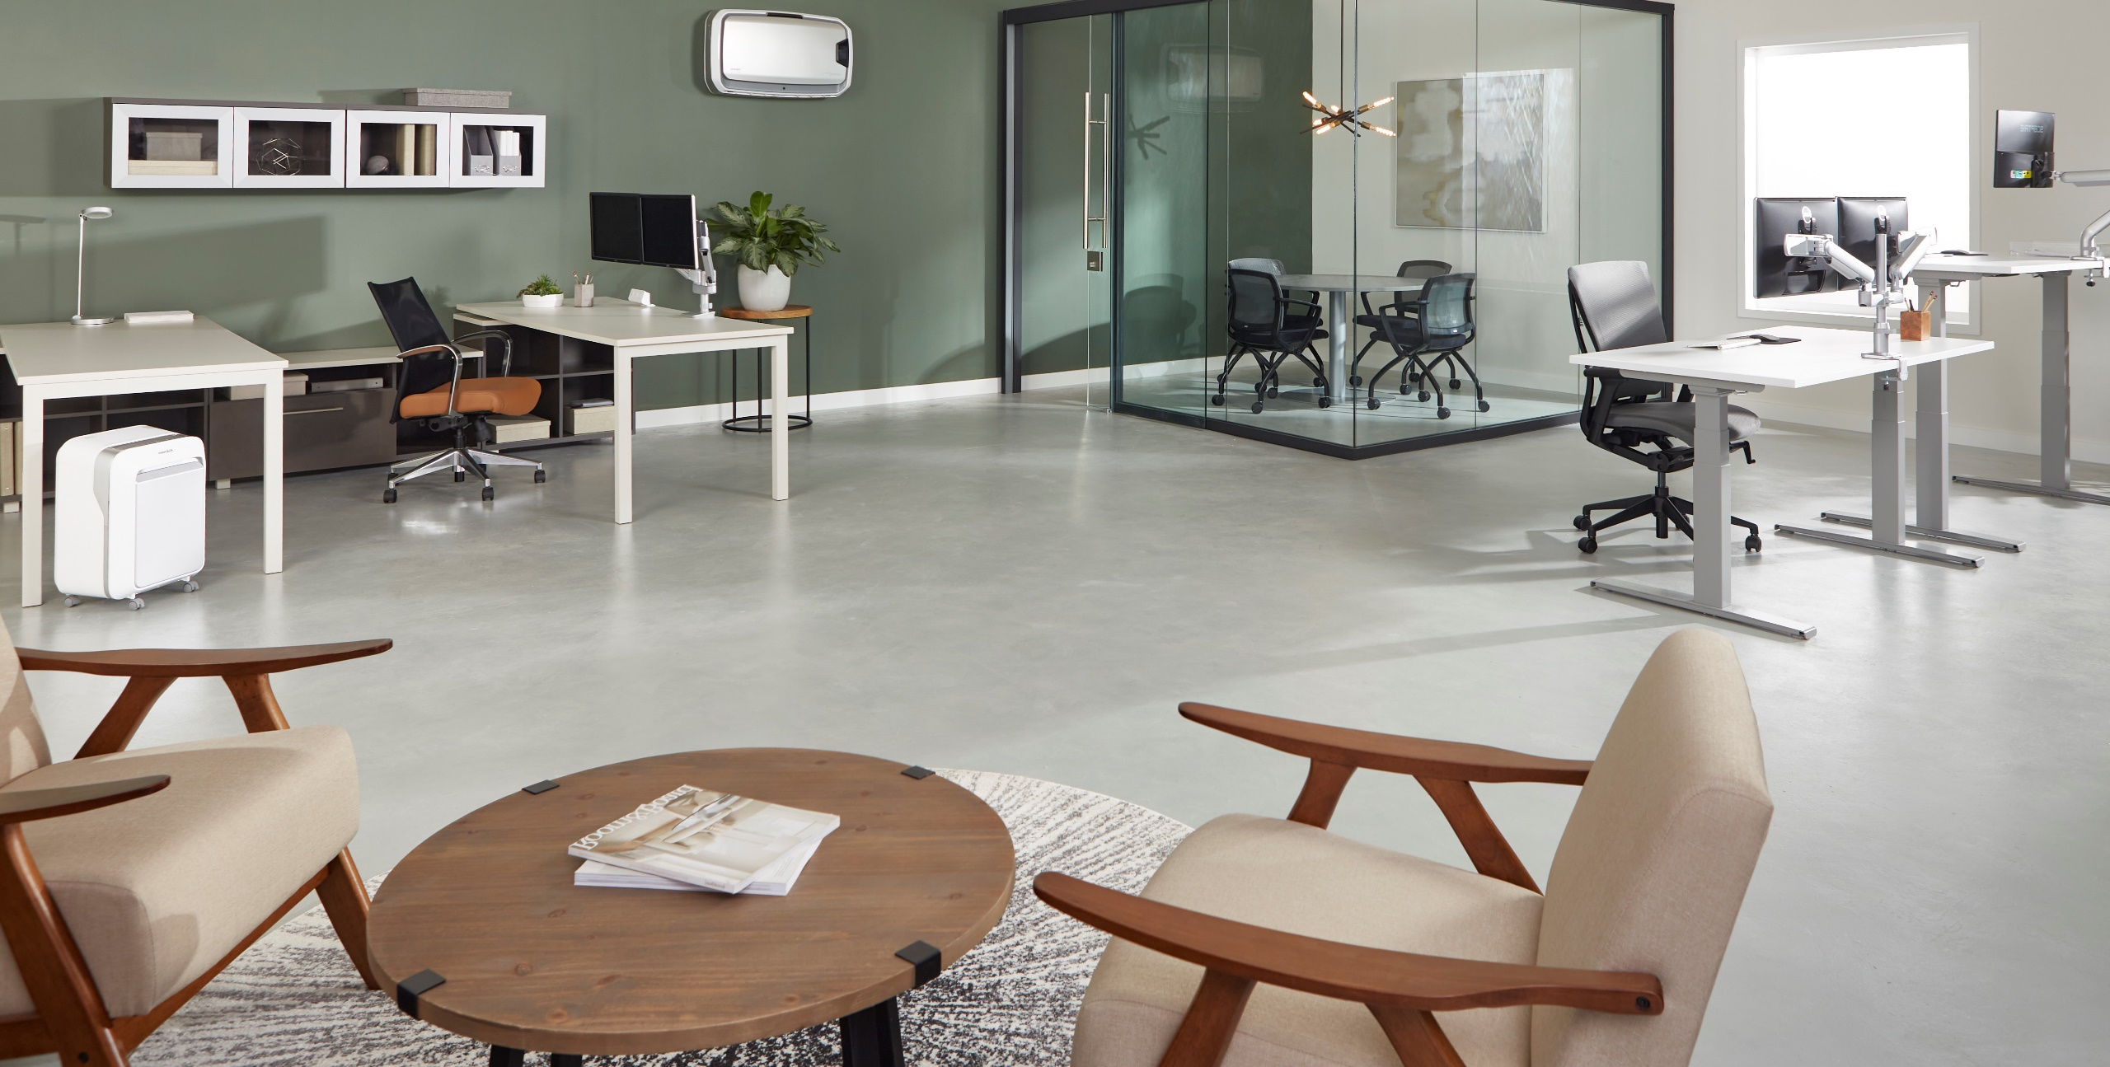
COMPANY INFO

Slide 11

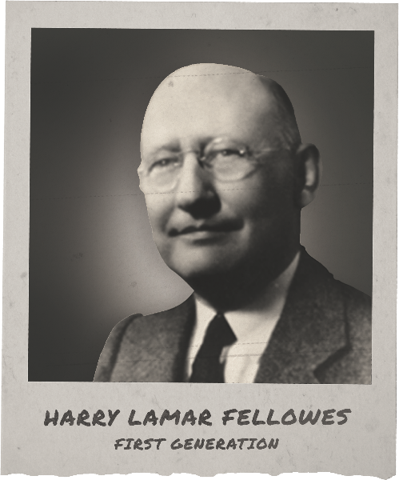
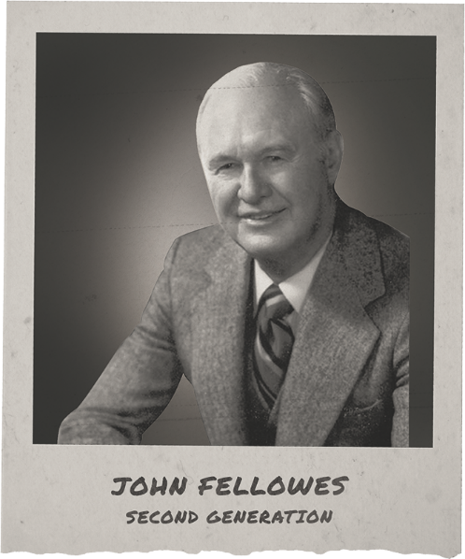
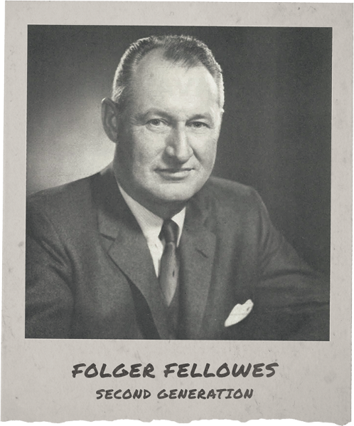
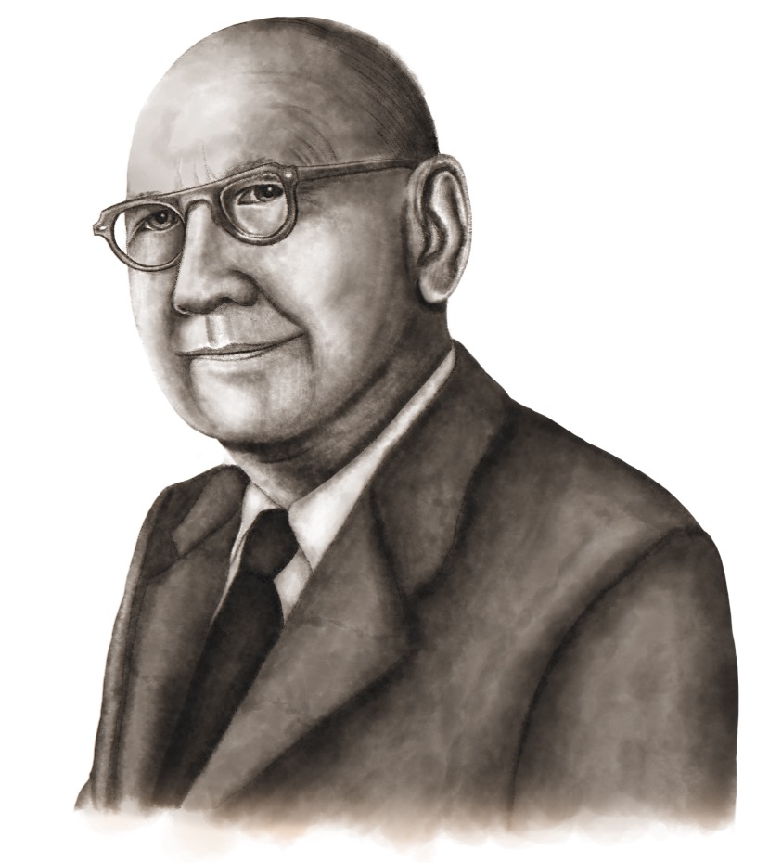



FAMILY BUSINESS SINCE 1917
4 Generational Journeys
With each generation, Fellowes has built forward and evolved to position its future in a state that is able to be a great employer, add value to its customers and build trust across those we serve.
When Harry Fellowes started selling his Bankers Box in 1917, he set out to build a different kind of company.
One that would be guided by a set of values.
Driven by a committment to integrity.
Devoted to serving customers, and building trust through addressing their challenges.
This set of values, this unwavering sense of purpose, has directed Fellowes for 105 years and across four generations of family leadership.
More importantly, it propels us into our future.
Foundational Values
FAMILY
INNOVATION
QUALITY
CARE

Slide 12
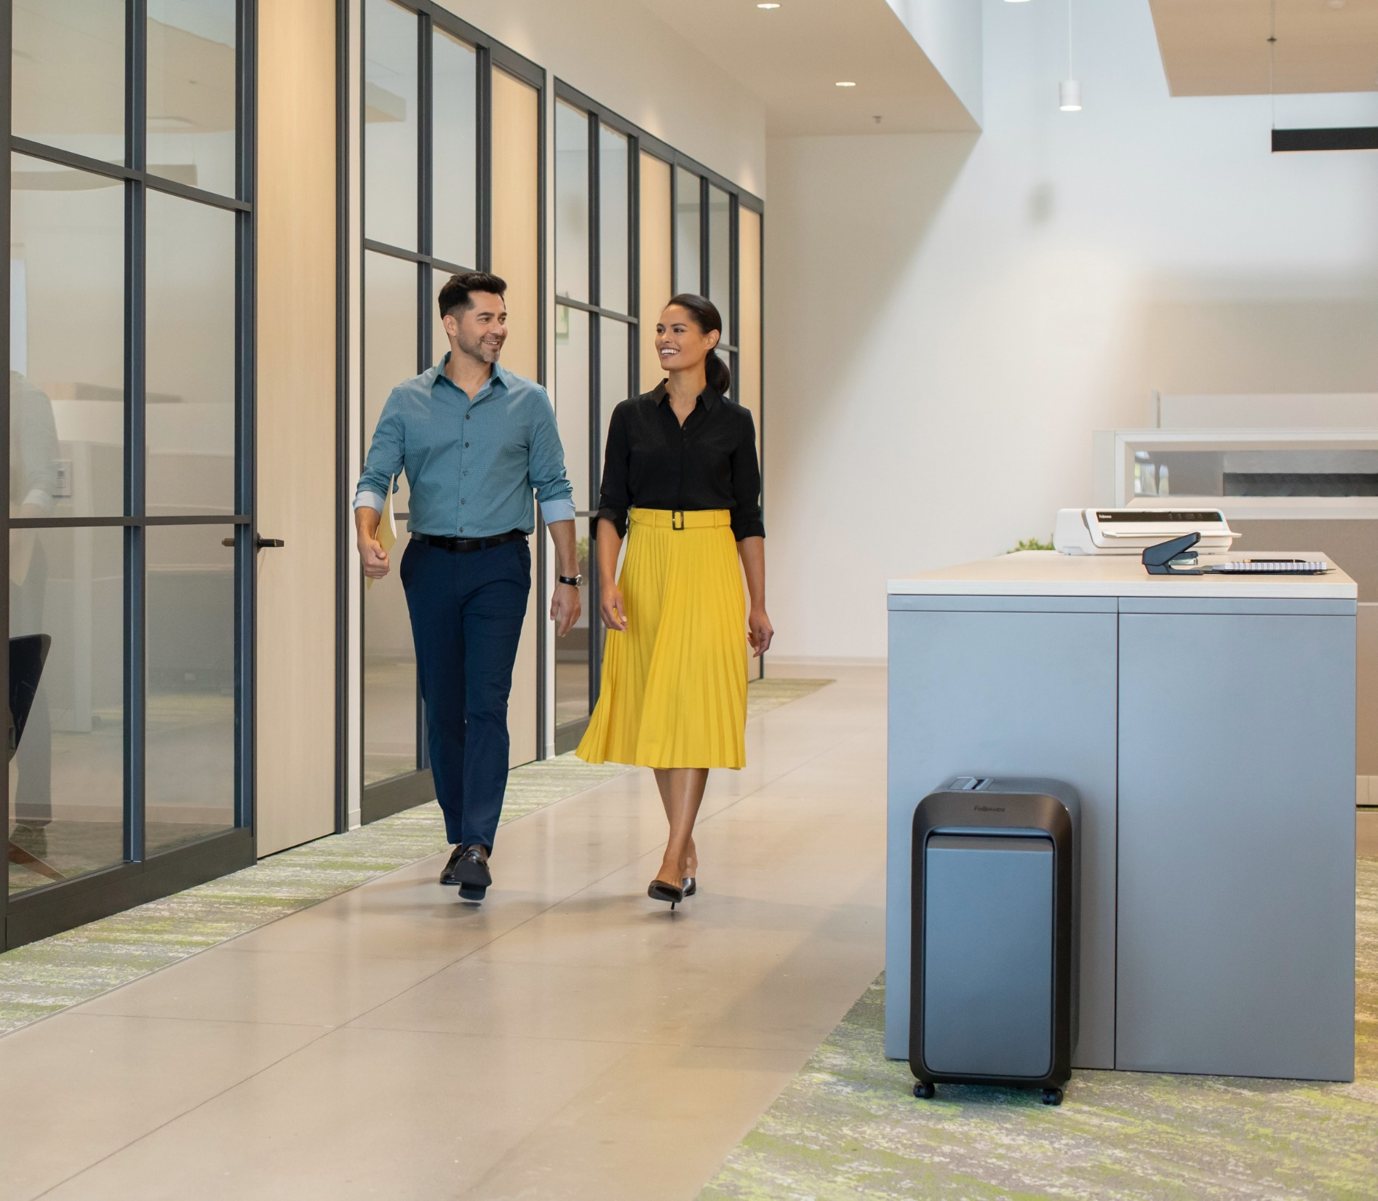

Celebrating its 106th year under the private ownership and executive leadership of the Fellowes family, Fellowes is a global leader and trusted partner that provides product solutions to fulfill WorkLife needs. Fellowes offers one efficient, streamlined source for modular walls, furniture, business machines, commercial air purification and commercial grade workspace products. Headquartered in Itasca, Illinois, USA, Fellowes operates from 24 locations across the globe.

Slide 13
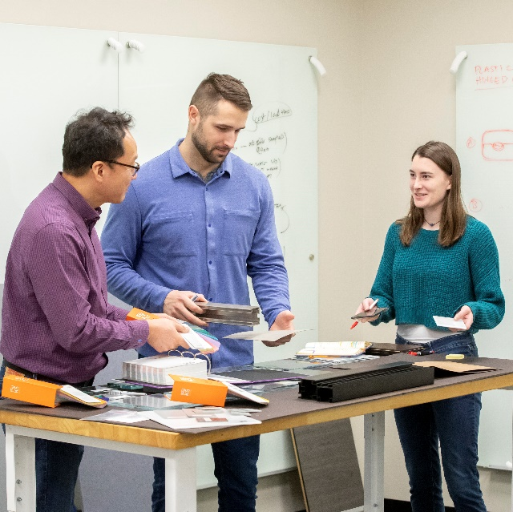
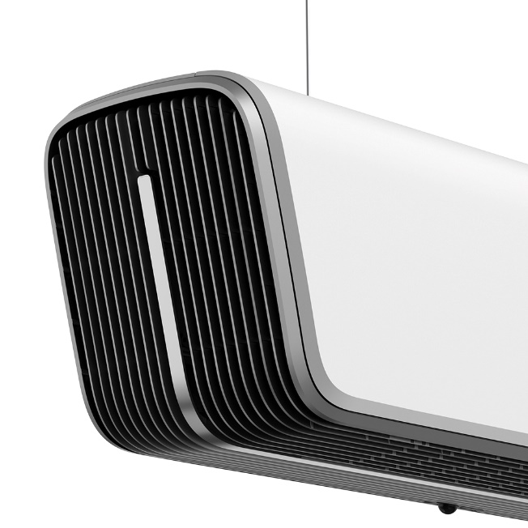
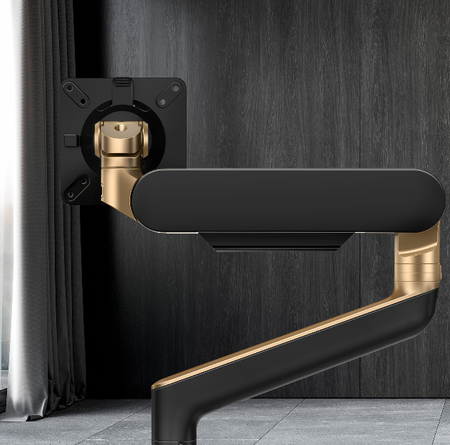

SERVING AT THE INTERSECTION OF
Family
Innovation
Quality
Care
For our 100 years, we have treated our customers and employees as family – serving tirelessly and effectively to help them thrive. Our culture is set to be professionally rewarding, but also personally engaging.
We believe in combining imaginative thought with a pragmatic approach to constantly outperform our current solutions, services and capabilities to transform how work gets done for an ever-changing world.
We invest in best-in-class facilities, tools, resources, engineering labs and development programs to deliver products that exceed industry quality standards.
As a 'company with a conscience’ we are dedicated to improving the lives of our customers, employees, communities and the planet. People are why and how we do what we do. Whether a customer or a teammate, there is the opportunity to have a positive impact.

Slide 14
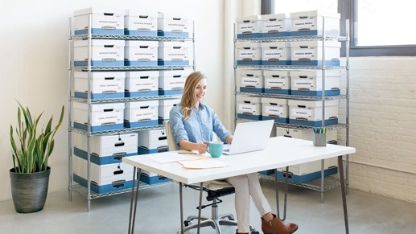
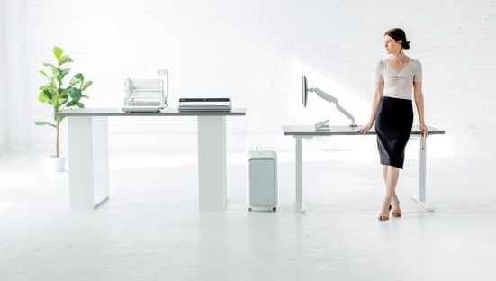
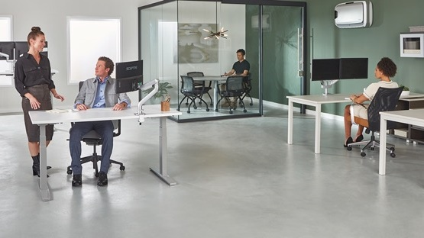
Our Journey & Evolution
Beginnings (1917-1983)
Preserve and Protect Work Records
Expansion (1984-2017)
Workspace Products
Re-Definition (2018-2023+)
WorkLife Solutions
Notes:
Today, goes beyond productivity, how you feel, impacting at a greater level

Slide 15
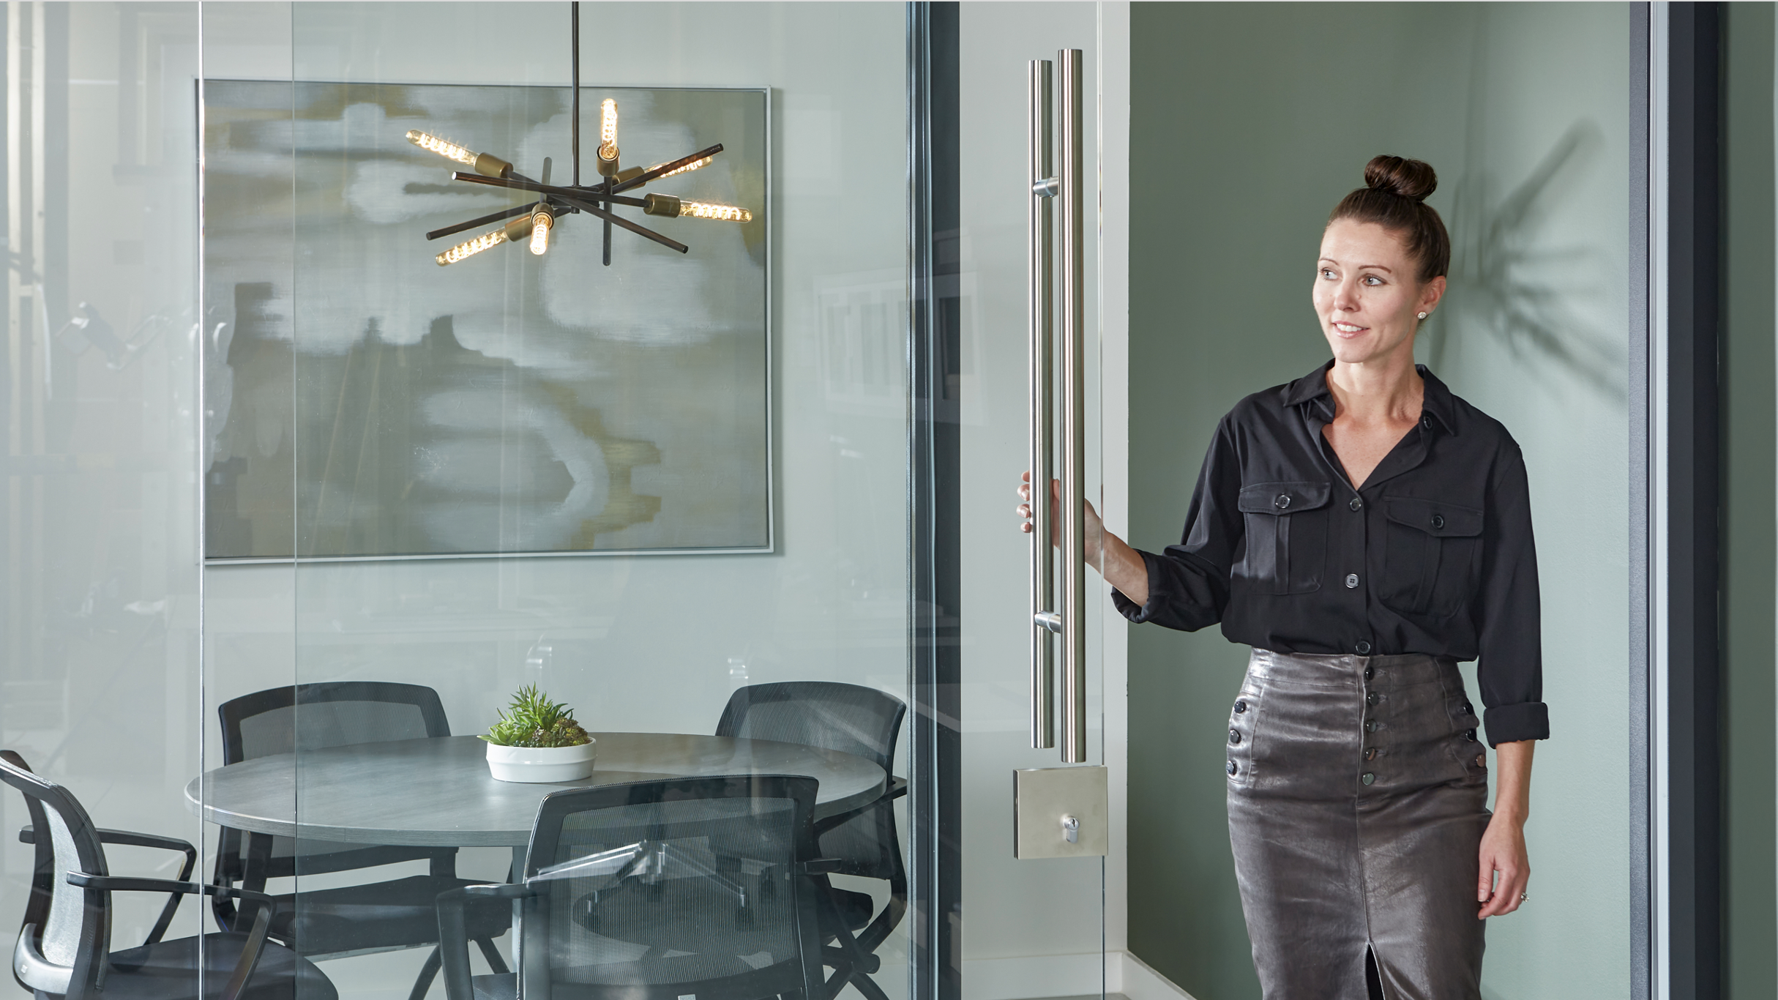


Unleashing WorkLife Potential

Slide 16
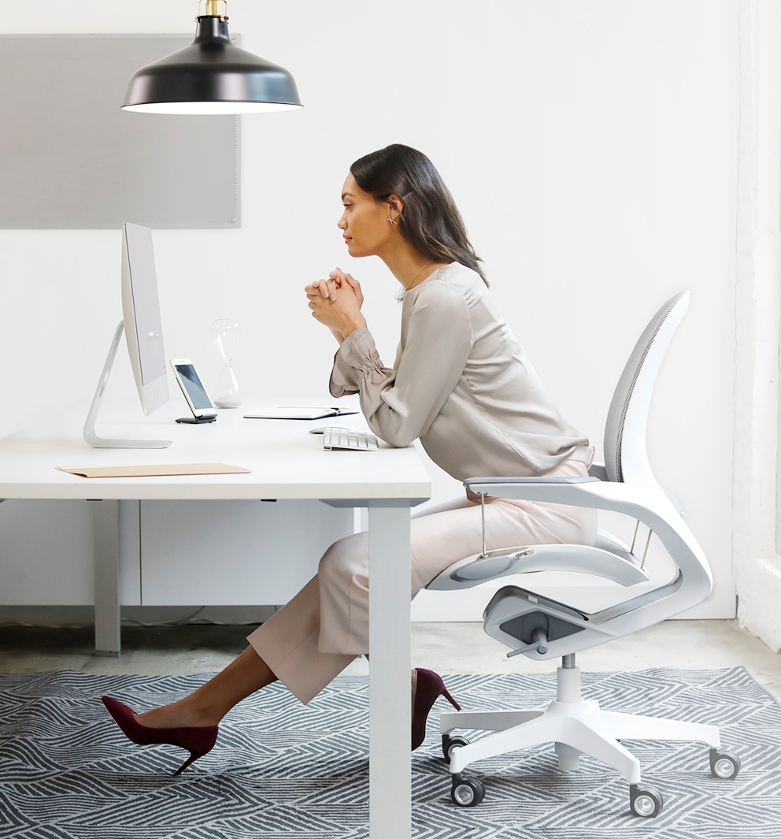
We all have work to do. Work that only we can do. Because work is more than completing tasks and meeting deadlines. It’s about reaching new levels of mastery. Realizing new dimensions of impact. Bringing new outcomes to light. It’s about moving, ever slowly, towards your potential.
At Fellowes, our work is defined by creating the products, systems, and environments that empower you to do yours. From the most minute and seemingly mundane tasks to elevated environments, we build the inspiring WorkLife where your potential is imagined today, and reached tomorrow.
Notes:
2017 - study

Slide 17
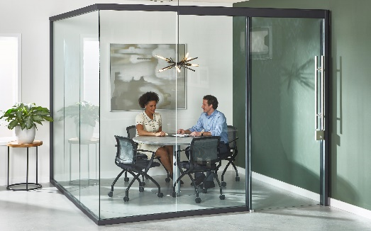
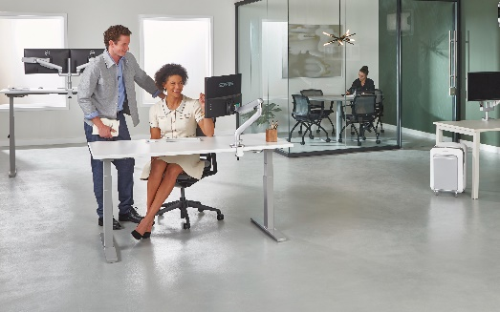
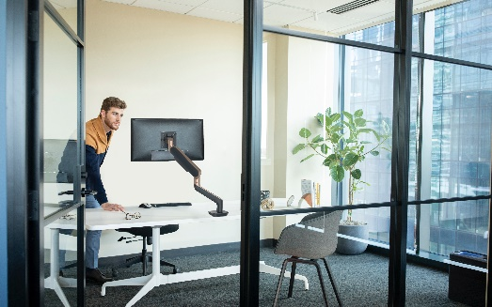
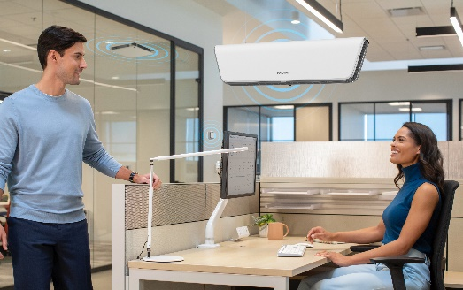
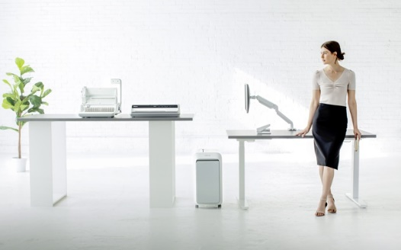
Product Categories
Modular Walls
Furniture
Workspace
Air Quality Management
Business Machines
Titan™
Workstations
Monitor Arms
Networked Air Purifiers
Paper Shredders
Volo™
Active Seating
Power Solutions
AeraMax™ Air Purifiers
Laminating & Accessories
Trendwall™
Tables
Lighting
Monitoring
Binding & Accessories
Table Enhancements
Ergonomic Accessories
Filters & Accessories
Stapling
Storage
Collections

Slide 18



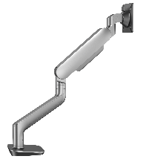
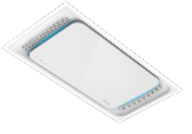

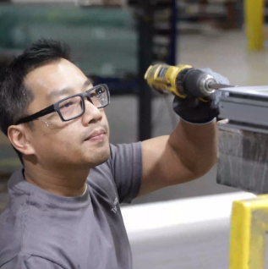

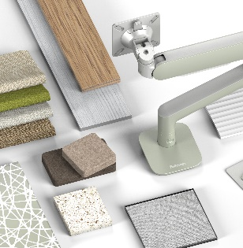
Centralized & Intentional
SUSTAINABILITY PROGRAM
New & Higher performance
OPERATIONS & SYSTEMS
New and Improved DESIGN AND EXPERIENCE SHOWROOM
3 Years of PRODUCT LAUNCHES in 1 Year
Enhanced PERFORMANCE & SERVICE PROGRAMS
Manufacturing
OPTIMIZATION
Better DIGITAL TOOLS &
DIGITAL MARKETING
New and Improved VISIONS MATERIAL PROGRAM

Slide 19
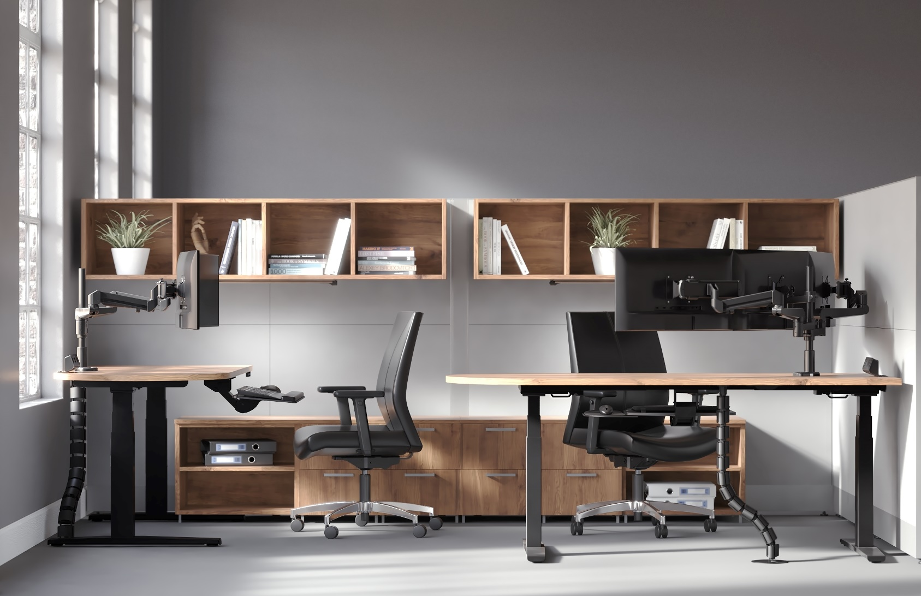
WORKSPACE
Products

Slide 20
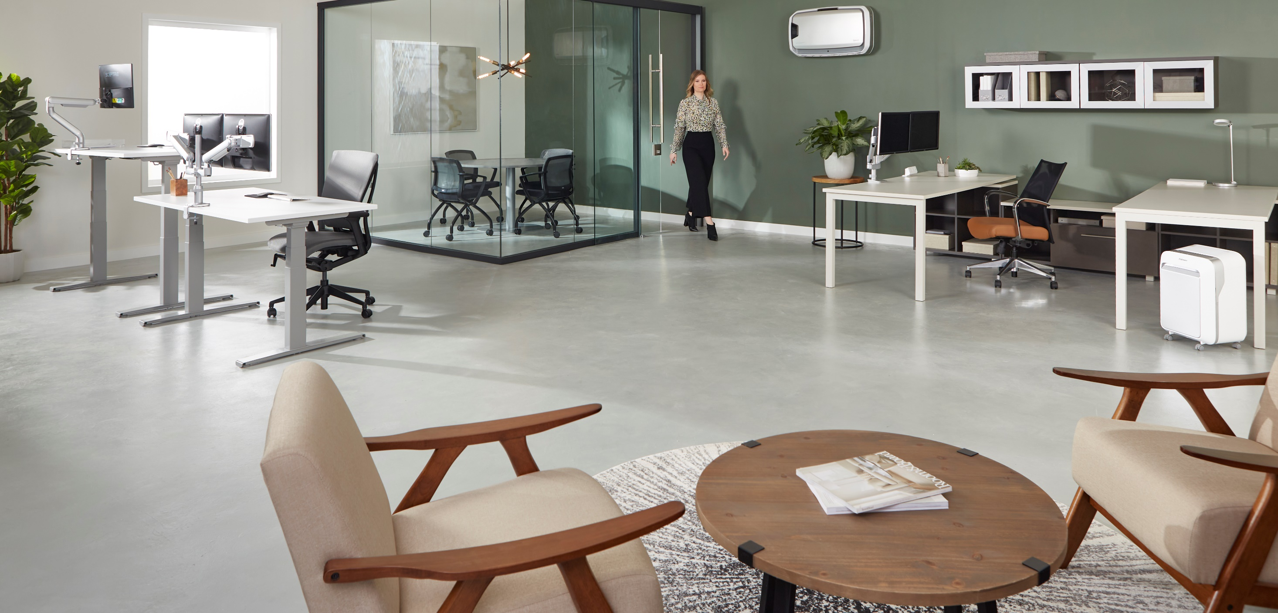

Slide 21
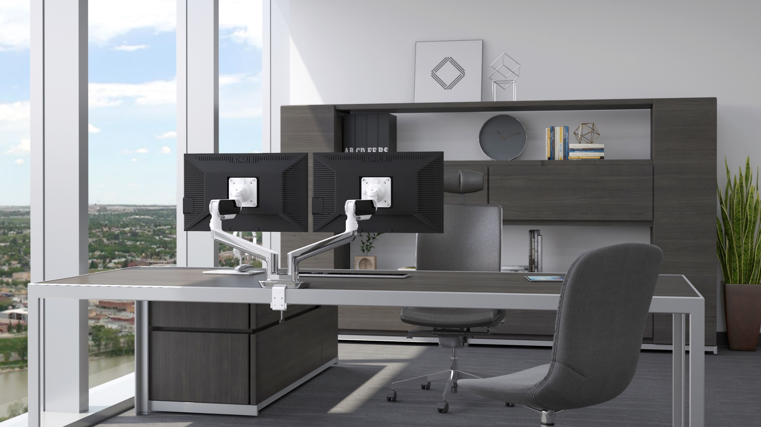

Slide 22
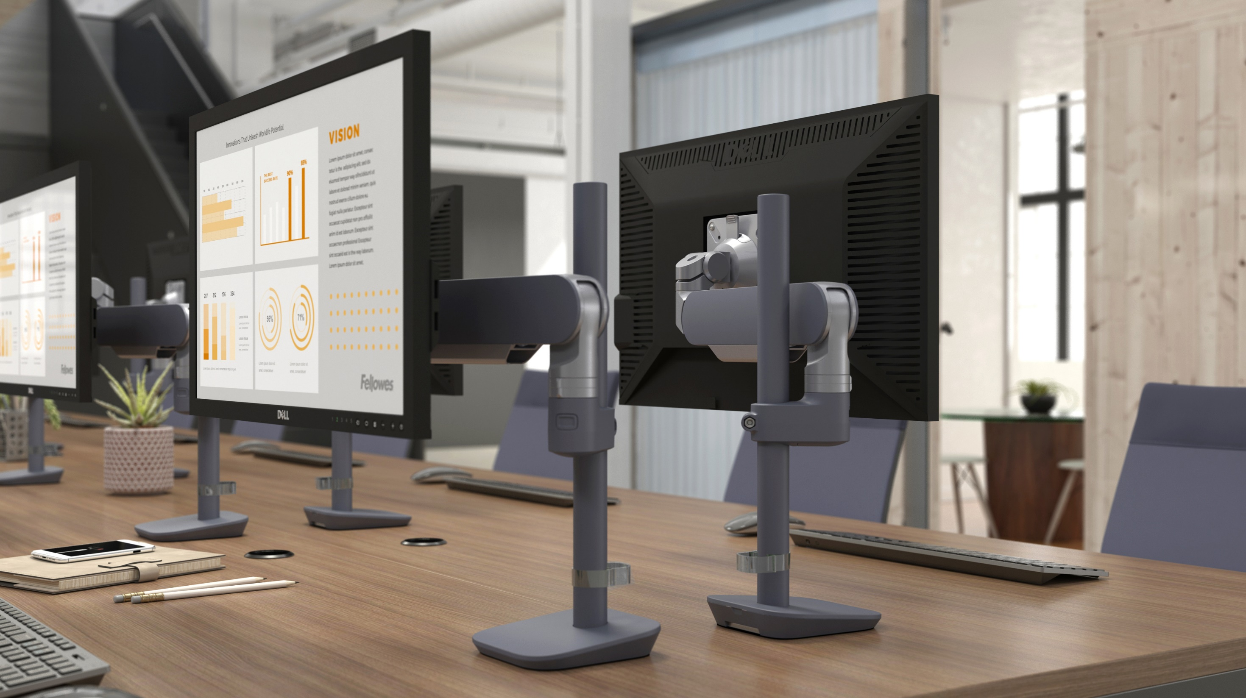

Slide 23
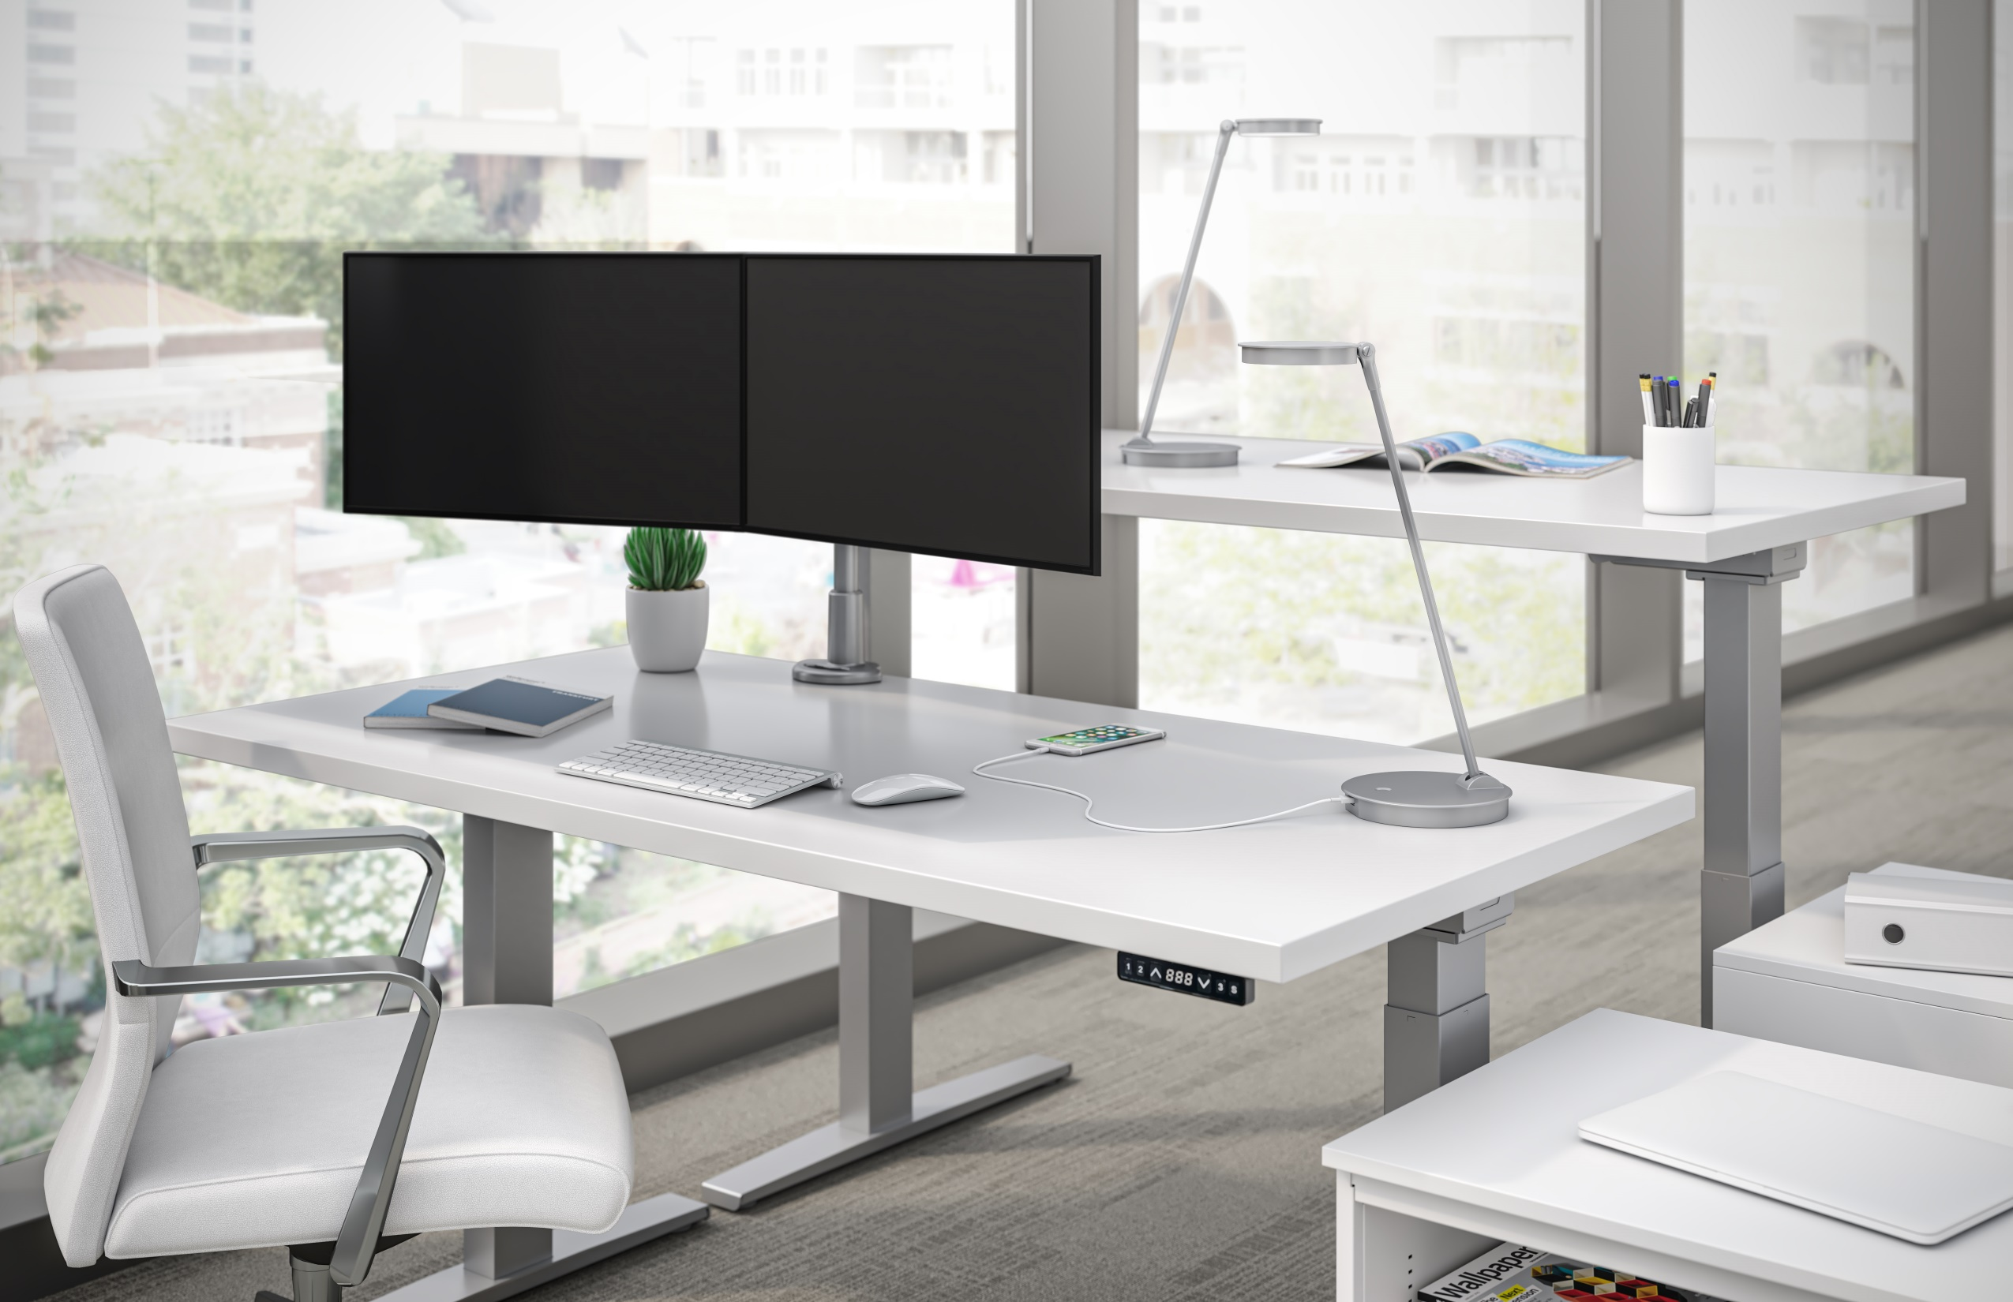

Slide 24
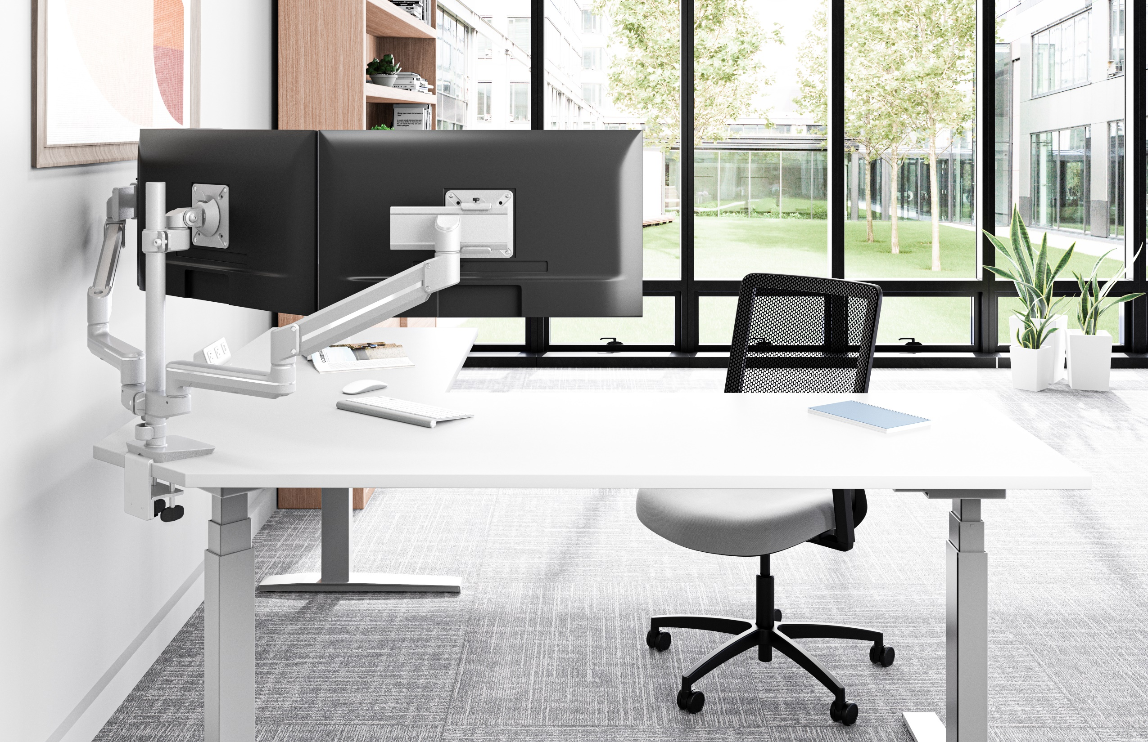

Slide 25
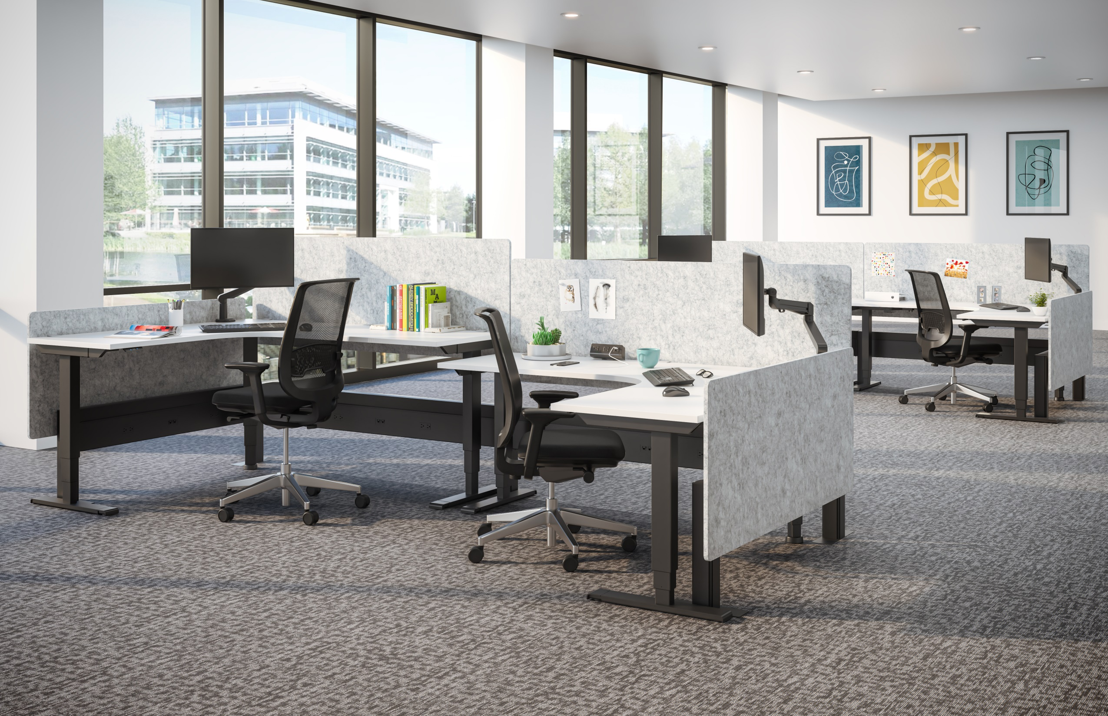

Slide 26
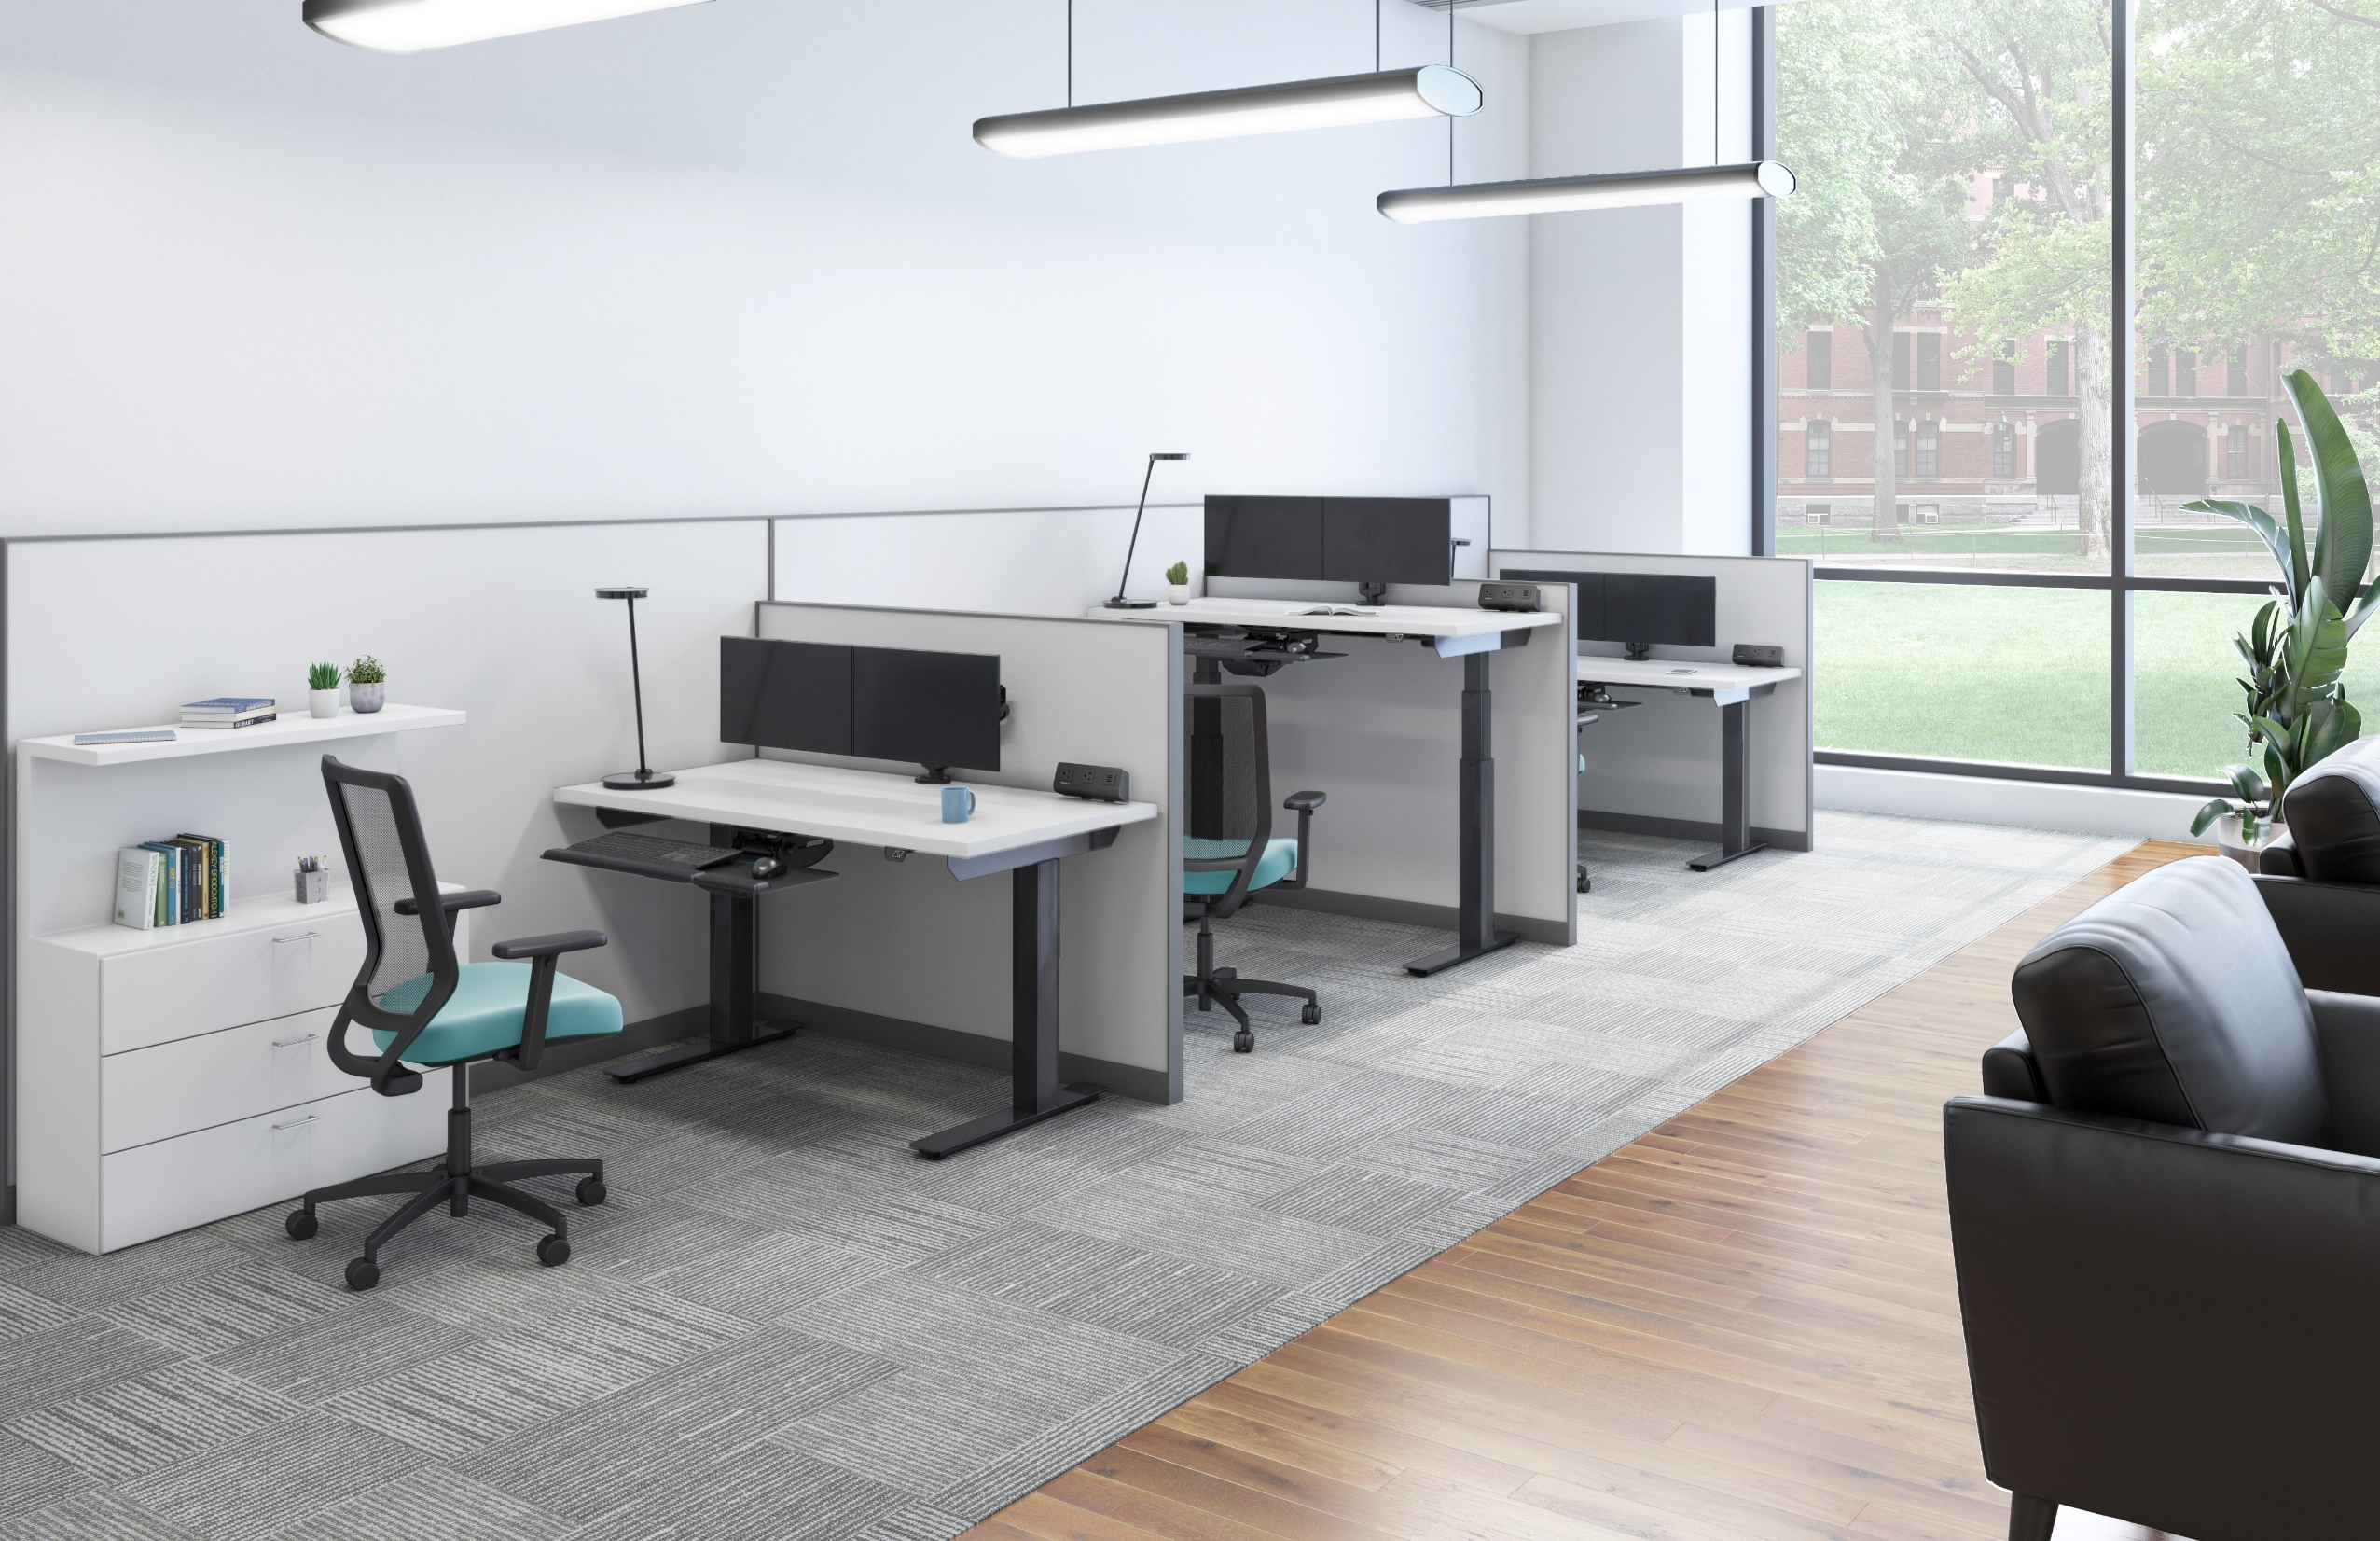

Slide 27
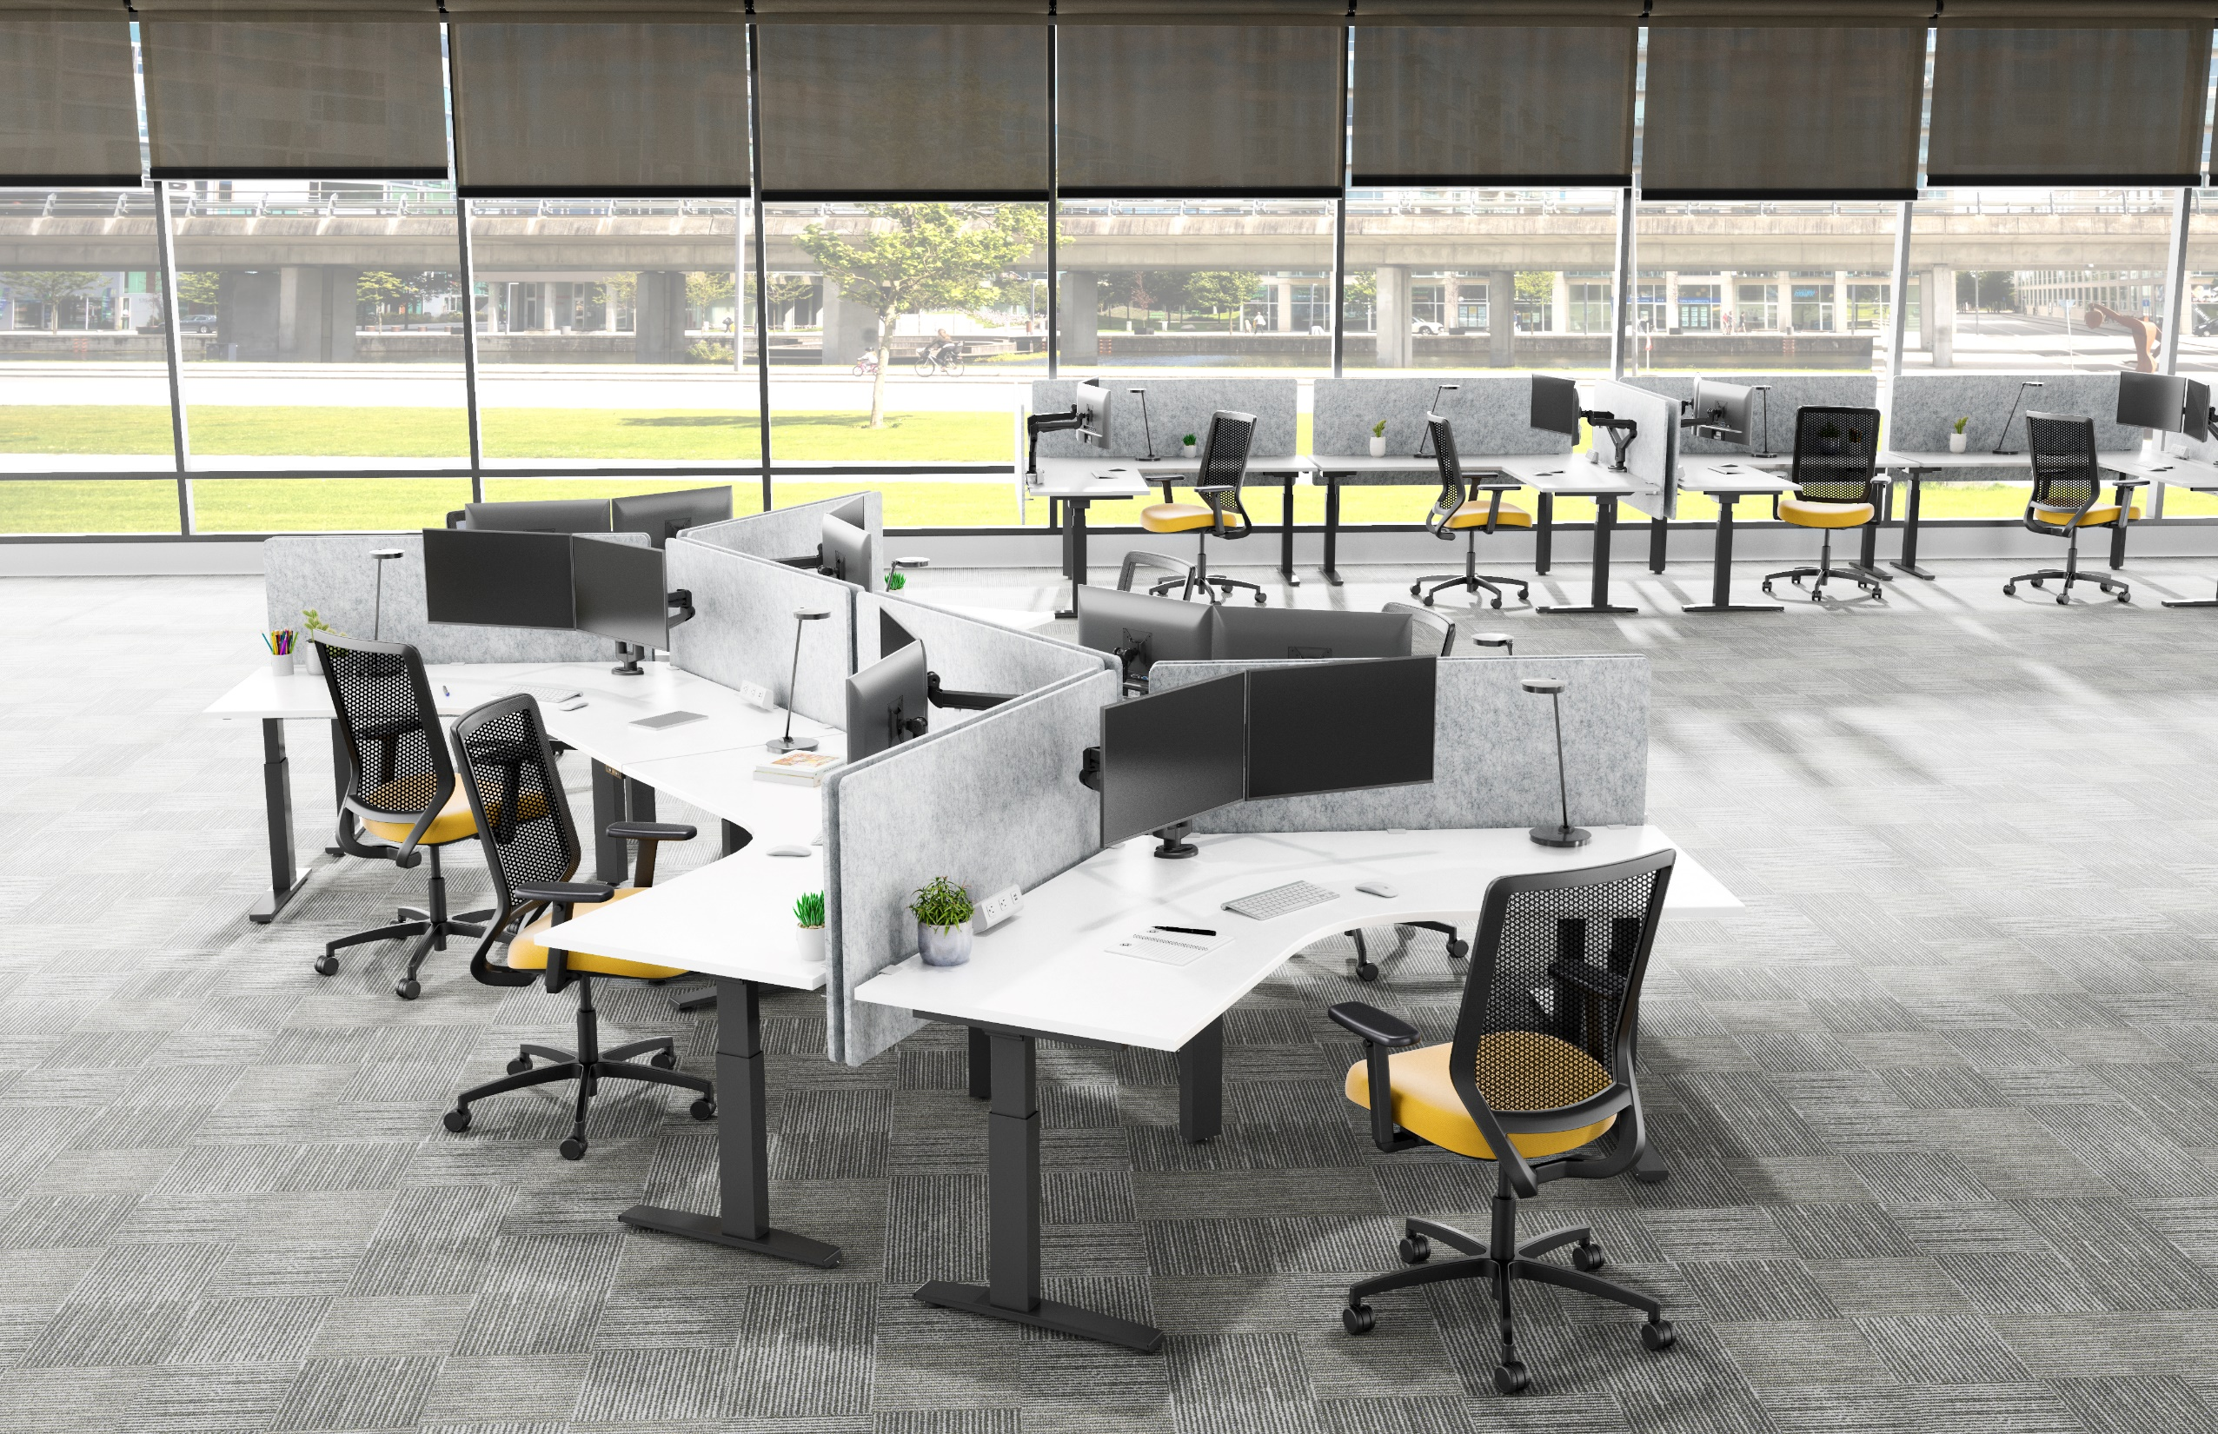

Slide 28
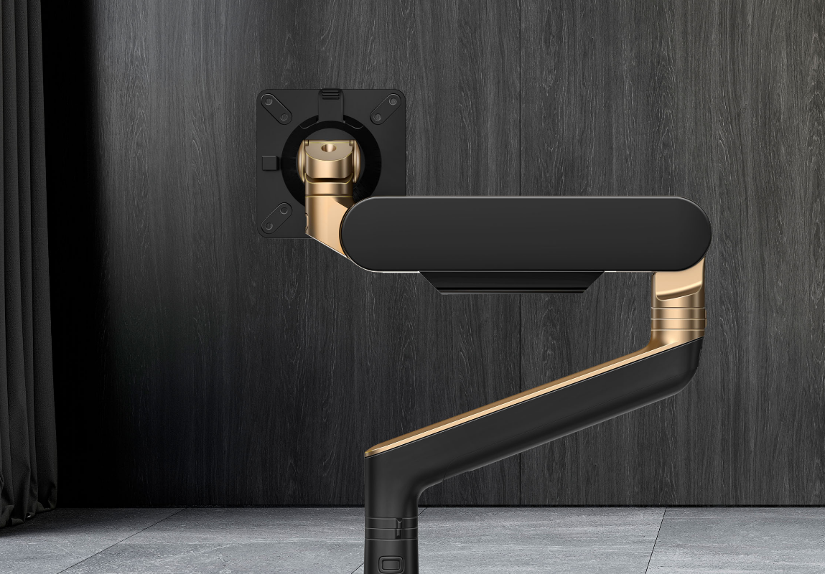
WORKSPACE
Cut Sheets

Slide 29
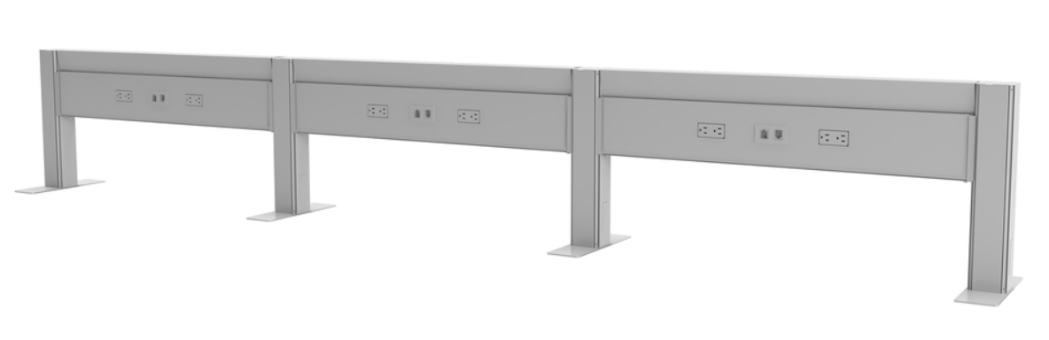
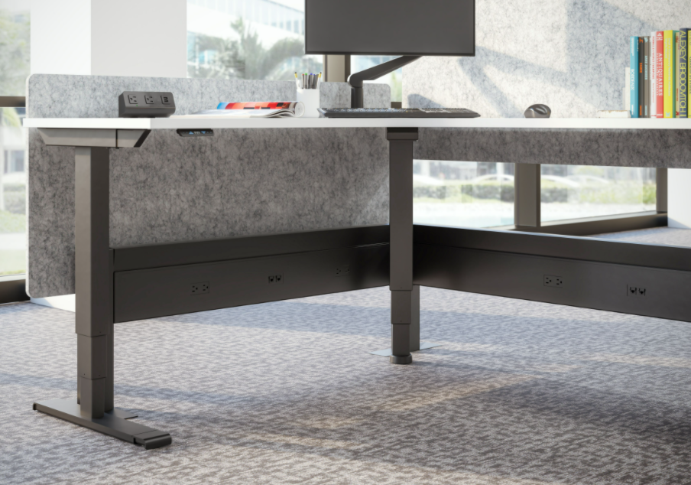
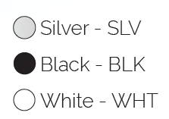
Railway™
Power and Data Solution
Product Specs
• Four available widths: 36.0”, 48.0”, 60.0”, and 72.0”
• 18.0”h x 3.3”w post
• 3.6”w x 12.0”d T foot - (standard) 3.6”w x 7.8”d L foot - (optional)
• Power and data can be utilized on both sides of the rail
• Separate cable/data channel that allows for lay-in cable runs
• Up to ten rails can be connected to each other
(for anything over ten rails, contact a local electrician)
• Up to eight 125V AC outlets per rail and four inputs for data
• Specify base or ceiling feed
• Flexible power feeds with 3.5" of extension through flexible
metal conduit
• UL listed as an Office Furnishing Accessory (UL1286), UL183, and
in full compliance with NEC electrical specifications
• Optional electric compliance available for municipal standards
such as NY Box, California Title 24, and Chicago
Please reference the Railway Spec Guide for more details
• 20 amps
• Four circuits, eight wire Byrne™ 8trac system
- Only receptacles 1 and 2 are sent with orders. Contact
Customer Service if additional receptacles are needed
• Up to 13 duplex receptacles per circuit (total of 52 available
duplex receptacles allowed)
• 12 AWG line conductors which share a 12 AWG ground and
AWG neutral
• Fourth circuit is isolated and dedicated
• Warranty: 10 Years
*Note: Circuits #1 & #2 Included, Additional Wiring Systems Available Upon Request

Slide 30
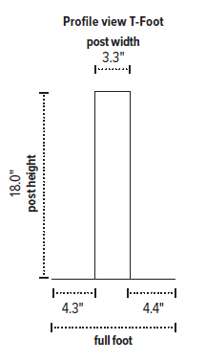
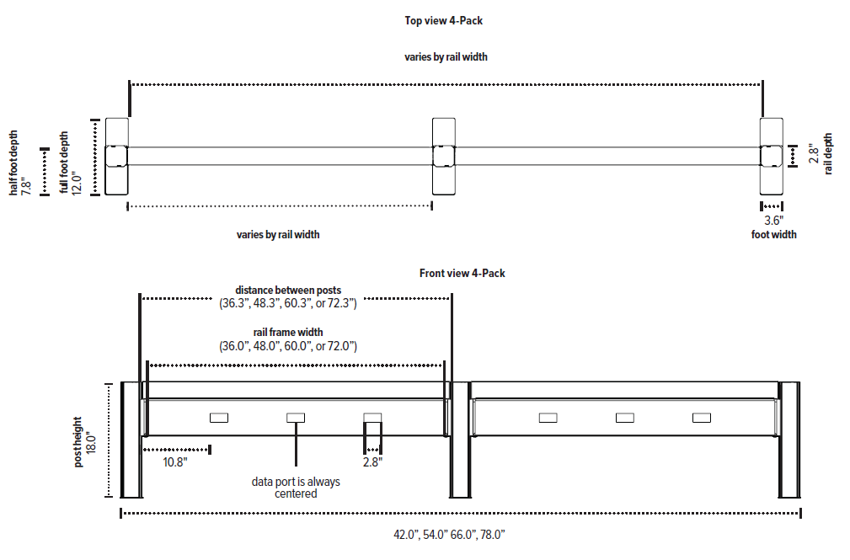
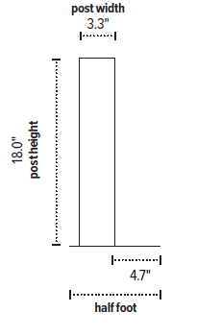
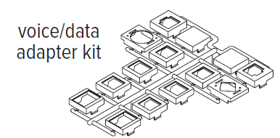
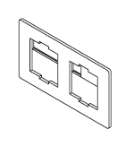
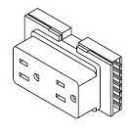
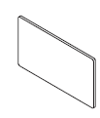
profile view T-foot
Railway™
Power and Data Solution
top view 4-pack
front view 4-pack
profile view L-foot
voice/data
adapter kit
voice/data plate
receptacle
cover plate

Slide 31
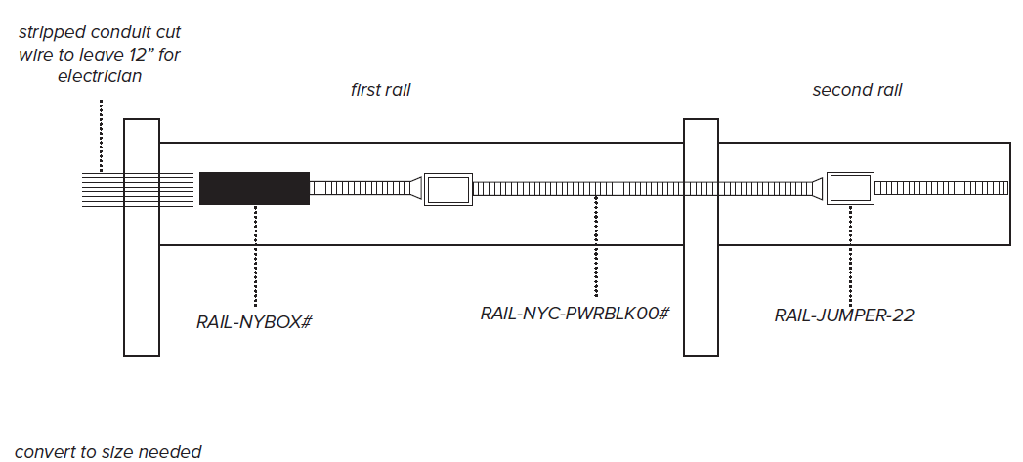
Railway
Power and Data Solution
New York City Power Rail Kit
Due to the New York City electrical code requirements, we offer a specific NYC power rail kit that meets all specification requested by the city. All parts are included and need to be installed by a licensed electrician per the code.
The NYC power rail kit is to be used as the designated infeed rail. All other rails in the configuration can be our standard rails
Please consult local electrician for power draw when connecting more than 5 rails to one endfeed.

Slide 32
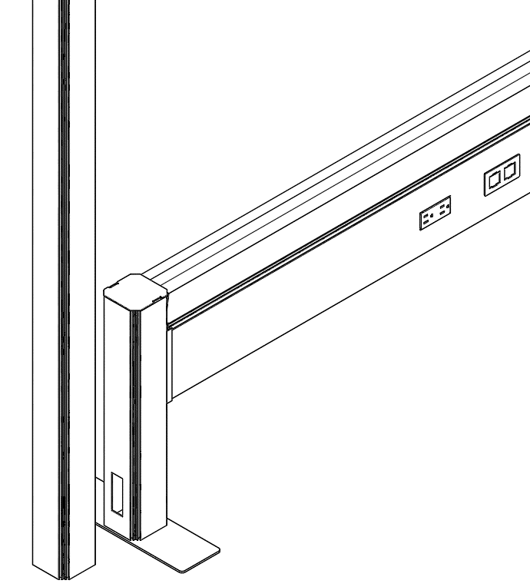
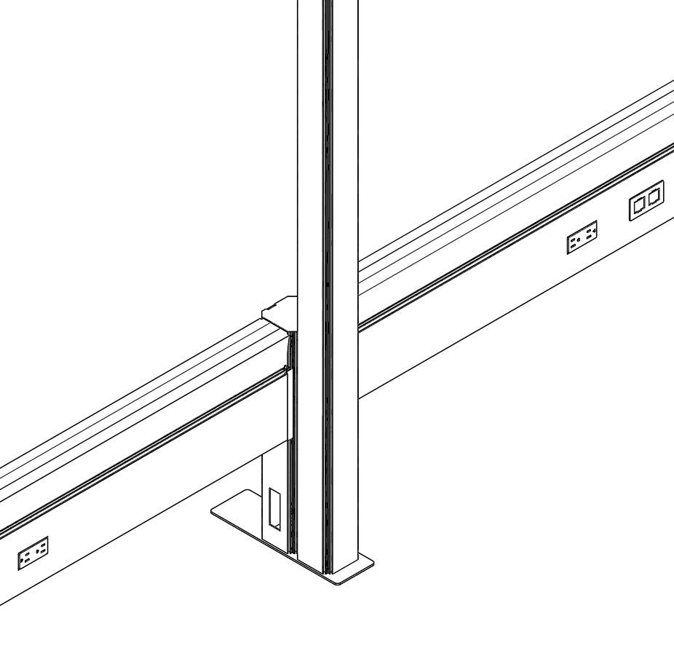
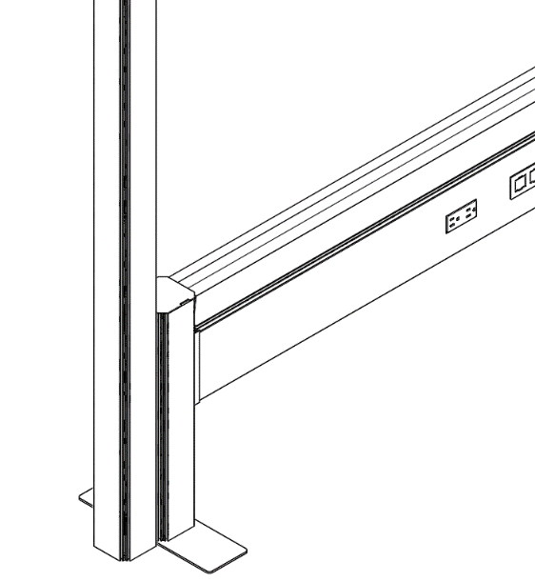
Railway™
Power and Data Solution
A 144.0” ceiling feed is used when power must be hardwired and “dropped” in from the ceiling. Specify power pole separately (also compatible with California Title 24).
Fellowes offers special feeds that comply with municipal standards for building and power for NY Box (-NY). Please check if any of these special power feeds are needed on the project.
Chicago Code Railways do not include receptacles, base/ceiling feed or jumpers.
Please contact your local electrician for sourcing these items.
When ordering for Chicago Code applications, receptacles should measure 1.125" in depth minimum so block protrudes beyond the face of the rail.
The power pole sits next to the Railway system; this does not attach or tie into the Railway system itself
The power pole is 3.0” x 3.75” x 142” long
It attaches to the post on its 3.0” side. Which means it will lengthen the Railway by 3.75”
Only available in black plastic
Power Pole (RAIL-POLE-142) & Ceiling In-Feed (CEILINGFEED-144)
Power Pole (RAIL-POLE-142) & Ceiling In-Feed (CEILINGFEED-144)
180° Inline Post With Knockout For In-Feeds (POSTKIT-180KO-DBL)
End Post Includes Knockout For In-Feeds (POSTKIT-180KO-DBL)
Slide Power Pole So It Sits Up Against The End Post
Field Cut Opening For In-Feed To Exit Power Pole To Enter Railway System @Post W/Knockout
Field Cut Opening For In-Feed To Exit Power Pole To Enter Railway System @Post W/Knockout

Slide 33
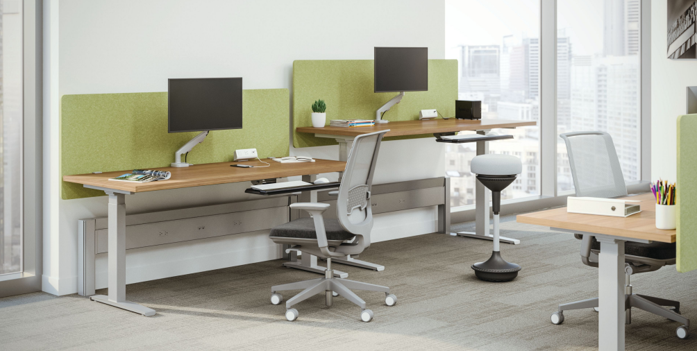
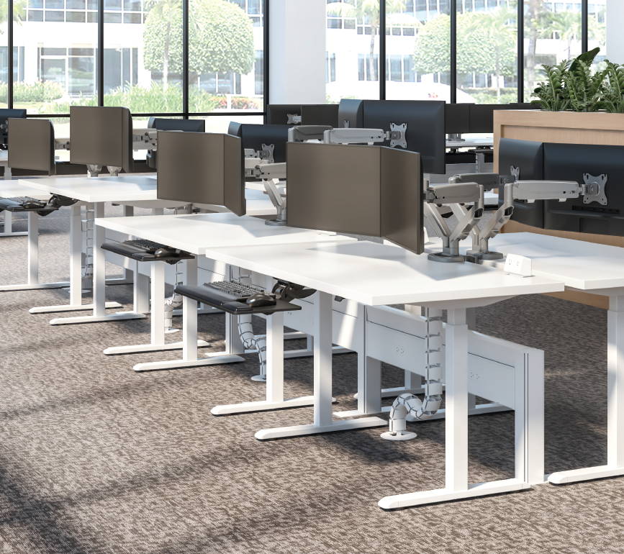

Railway™
Power and Data Solution

Slide 34








Worksurfaces Overview
Available shapes and woodgrain pattern direction:
Please see the diagrams for the direction of the woodgrain pattern on each worksurface shape.

Slide 35






Worksurfaces Overview

Slide 36




Triumph™ LX
Electric Height Adjustable Table Base
Product Specifications
Electric height adjustment
250 lb. base lifting capacity
1.4"/sec. adjustment speed
17.0" height adjustment range
- 26.5"–43.5"(low/high) (excluding worksurface)
Two stage adjustable legs
C-leg
Frame and column connect and lock for quick and easy assembly
Adjustable width frame accommodates worksurfaces 36.0"–72.0"
Two motors
Digital keypad with three memory settings
Soft start and stop
Gyro sensor anti-collision
Locking casters are available
ADA compliant
8’9" power cord
Steel frame and foot construction
Works with peds or storage with 23.5" max. height
Low standby power consumption
Meets or exceeds BIFMA x5.5 guidelines
Keypad can slide under worksurface to store out of the way
Complete tables available (base and top)
Warranty: Lifetime
digital keypad
connect and lock pre-assembly
connect and lock assembled

Slide 37

Victory™ LX 2-Leg
Electric Height Adjustable Table Base
Product Specifications
Electric height adjustment
250 lb. base lifting capacity
1.4"/sec adjustment speed
26.0" height adjustment range
- 21.5"–47.5" (low/high) (excluding worksurface)
Three stage adjustable legs
C-leg
Frame and column connect and lock for quick and easy assembly
Adjustable width frame accommodates worksurfaces 36.0"–72.0"
Soft start and stop
Gyro sensor anti-collision
Locking casters available
Two motors
ADA compliant
8’9" power cord
Table base is UL962 listed
Meets or exceeds BIFMA x5.5, GI and CSA CAN/ CGSB44.227
Works with peds or storage with 18.5" max. height
Low standby power consumption
Steel frame and foot construction
Digital keypad with three memory settings
Keypad can slide under worksurface to store out of the way
Complete tables available (base and top)
Warranty: Lifetime
digital keypad
connect and lock pre-assembly
connect and lock assembled

Slide 38



Trada™
Electric Height Adjustable Table Base
Product Specifications
Electric height adjustment
265 lb. base lifting capacity
1.5"/sec adjustment speed
25.5" height adjustment range - 24.5"–50.0" (low/high) (excluding worksurface)
Anti-collision
Three stage adjustable legs
C-leg
Adjustable width frame accommodates
worksurfaces 48.0"–72.0"
Soft start and stop
Locking casters available
Two motors
ADA compliant
9' power cord
Table base is UL962 listed
Meets or exceeds BIFMA x5.5, and CSA C22.2 #68 guidelines
Works with peds or storage with 22.0" max. height
Low standby power consumption
Steel frame and foot construction
Standard keypad with up and down buttons or digital 4-memory keypad available
Complete tables available (base and top)
Warranty: Lifetime
standard keypad with up and down buttons
digital 4 memory keypad

Slide 39


All-Flex® 2-Leg
Electric Height Adjustable Table Base
Product Specification
Electric height adjustment
265 lb. base lifting capacity
1.5"/sec adjustment speed
One part number for all 2-leg sizes
26.0" height adjustment range - 23.3"–49.3" (low/high) (excluding worksurface)
Three stage adjustable legs
Provides adjustable cross channels, top supports, and feet making it one of the most adjustable table bases on the market
C-leg
Foot is adjustable to 22.0" or 28.0" (patented design)
Leg columns fold out for easy assembly
Adjustable width frame accommodates worksurfaces 36.0"–72.0"
Adjustable depth top support expands to accommodate worksurfaces 24.0"–36.0" deep
Notched cross channel offers ample space for keyboard tray glide tracks
7'2" power cord
Digital keypad with four memory settings
Anti-collision safety feature
Soft start and stop
Crossbar includes guide markings to assist in setting width
Integrated control unit shelf
Integrated storage for foot extension plate when not in use
Integrated cable management
Steel construction
Low standby power consumption
Table base is UL962 listed
Two motors
ADA compliant
Locking casters are available
Complete tables available (base and top)
Warranty: Lifetime
digital keypad

Slide 40


Victory™ LX 3-Leg
Electric Height Adjustable Table Base
Product Specifications
Electric height adjustment
360 lb. base lifting capacity
1.4"/sec adjustment speed
26.0" height adjustment range - 21.5"–47.5" (low/high) (excluding worksurface)
Three stage adjustable legs
C-leg
Adjustable width frame accommodates worksurfaces 48.0"–84.0"
Three motors
Soft start and stop
Anti-collision safety feature
Locking casters available
Low standby power consumption
ADA compliant
8’9" power cord
Table base is UL962 listed
Meets or exceeds BIFMA x5.5, GI and CSA CAN/ CGSB44.227
Works with peds or storage with 20.0" max. height
Steel frame and foot construction
Digital keypad with three memory settings
Keypad can slide under worksurface to store out of the way
Complete tables available (base and top)
Warranty: Lifetime
drawers easily slide over feet
digital keypad

Slide 41


Weight Adjustable Espree™
Pneumatic Height Adjustment Table Base
Product Specifications
Pneumatic height adjustment
20.0" height adjustment range - 26.0"–46.0" (low/high) (excluding worksurface)
44–143 lbs. base lifting capacity(2ESP-WA-C48)
52–163 lbs. base lifting capacity(2ESP-WA-C60)
Two-stage adjustable legs
Foot is adjustable to 22.0" or 28.0" (patented design)
Fixed width frame
Locking casters are available
Table bases accommodate worksurfaces measuring 48.0" and 60.0" in width
Base includes weight resistance setting gauge
The user has the ability to change the weight resistance in the base for easy height adjustment
Counter-balanced columns provide smooth, synchronized height adjustment
The weight adjustment cylinder includes preventative hard stop
Warranty: Lifetime
weight resistance gauge
Easily adjusts according to weight of worksurface

Slide 42

All-Flex® 3-Leg
Electric Height Adjustable Table Base
Product Specifications
Electric height adjustment
330 lb. base lifting capacity
1.5"/sec adjustment speed
One part number for all 3-leg sizes
26.0" height adjustment range - 23.3"–49.3" (low/high) (excluding worksurface)
Three-stage adjustable legs
C-leg
Provides adjustable cross channels, top support, and feet making it one of the most adjustable table bases on the market
Foot is adjustable to 22.0" or 28.0" (patented design)
Adjustable width frame accommodates worksurfaces 36.0"–84.0" wide
Adjustable depth top support expands to accommodate worksurfaces 24.0"–36.0" deep
Notched cross channel offers ample space for keyboard tray glide tracks
7’2" power cord
Digital keypad with four memory settings
Anti-collision safety feature
Soft start and stop
Crossbar includes guide markings to assist in setting width
Leg columns fold out for easy assembly
Integrated control unit shelf
Integrated storage for foot extension plate when not in use
Integrated cable management
Steel construction
Low standby power consumption
Table base is UL962 listed
Three motors
ADA compliant
Locking casters are available
Meets or exceeds BIFMA x5.5 guidelines
Complete tables available (base and top)
Warranty: Lifetime
digital keypad

Slide 43



Trada™ 3-Leg
Electric Height Adjustable Table Base
Product Specifications
Electric height adjustment
397 lb. base lifting capacity
1.5"/sec adjustment speed
25.5" height adjustment range - 24.5"–50.0" (low/high) (excluding worksurface)
Anti-collision safety feature
Three stage adjustable legs
C-leg
Adjustable width frame accommodates worksurfaces 48.0"–72.0"
Soft start and stop
Locking casters available
Three motors
ADA compliant
9' power cord
Table base is UL962 listed
Meets or exceeds BIFMA x5.5, and CSA C22.2 #68 guidelines
Works with peds or storage with 22.0" max. height
Low standby power consumption
Steel frame and foot construction
Standard keypad with up and down buttons or digital 4-memory keypad available
Complete tables available (base and top)
Warranty: Lifetime
digital 4 memory keypad
Standard keypad with up and down buttons

Slide 44






Centro™
Privacy/Modesty Screen
Product Specifications
Available lengths: 22.0", 28.0", 34.0", 46.0", 58.0", and 70.0"*
25.0" height
Privacy application - 18.0“ above/6.0" below - Modesty application - 6.0“ above/18.0" below
0.8" screen thickness
22.0", 28.0", 34.0" and 46.0" screens come with two worksurface mounting brackets, 58.0" and 70.0“ screens come with three brackets
46.0" and 58.0" screens in Charcoal and Ash ship in 48 hours
Mounting brackets designed to accommodate 0.5"–1.8" thick worksurfaces
Lightweight screens
Sound level absorption up to .9 NRC rating
Universal mounting system allows brackets to be set for privacy or modesty applications
Convenient tackable surface
100% recyclable
Made from 60% post-consumer recycled plastic water bottles
VOC-Free
22.0" and 28.0" lengths are recommended for side applications. Larger sizes are recommended for the rear applications
Seven available colors: Cobalt Blue, Pear Green, Sandstone, Ash, Charcoal, Slate, Iced Grey
Custom options are available: Contact our Customer Service Department for a customized Centro quote. Minimum quantity of four required. Additional costs and lead time may apply
Warranty: 5 Years
used as privacy
screen application
used as modesty
screen application

Slide 45



Rising™
Monitor Arm
Product Specifications
Finger touch dynamic height adjustment
Recommended for worksurfaces 36” deep or less
11.7” height adjustment range - 8.2”–19.9” (low–high)
22.4” arm extension
3.5” arm retraction
+45º/-30º monitor tilt
+/-90º VESA rotation
4.5lb.–28.0lb. weight capacity
VESA 75mm/100mm quick release
RotationStop lock-out feature (14 distinct locations)
Desk clamp and grommet mount included
Meets or exceeds BIFMA x5.5 guidelines
Warranty: Lifetime
RotationStop™ allows 14 distinct stop locations with no special tools or disassembly required
SnapKinect™ fast and easy assembly

Slide 46

Rising2™
Monitor Arm
Product Specifications
Finger touch dynamic height adjustment
Recommended for worksurfaces 36” deep or less
19.9” height adjustment range - 8.2”–11.7” (low–high)
22.4” arm extension
3.5” arm retraction
+45º/-30º monitor tilt
+/-90º VESA rotation
4.5lb.–28.0lb. weight capacity (per arm)
Max monitor width (bezel measured left to right): 42.3”
VESA 75mm/100mm quick release
RotationStop lock-out feature (14 distinct locations)
Desk clamp and grommet mount included
Meets or exceeds BIFMA x5.5 guidelines
Warranty: Lifetime
RotationStop™ allows 14 distinct stop locations with no special tools or disassembly required
SnapKinect™ fast and easy assembly

Slide 47

RisingEX2-MS™
Monitor Arm
Product Specifications
Finger touch dynamic height adjustment
Recommended for worksurfaces 30” deep or less
24” height adjustment range - 3.6”–27.6” (low–high)
15.8” arm extension
5.8” arm retraction
+45º/-30º monitor tilt
+/-90º VESA rotation
3.5lb.-27.0lb. weight capacity (per arm, not to exceed a total of 60lb.)
Max monitor width (bezel measured from left to right): 36.3”
16.0” pole height (includes base)
VESA 75mm/100mm quick release
RotationStop lock-out feature (14 distinct locations)
Desk clamp and grommet mount included
Meets or exceeds BIFMA x5.5 guidelines
Warranty: Lifetime
RotationStop™ allows 14 distinct stop locations with no special tools or disassembly required
SnapKinect™ fast and easy assembly

Slide 48



Rising™
Finishes
*minimum order quantity: 300
*lead time: 10 weeks

Slide 49






Kata™ EX2-MS
Dual Motion + Slider Monitor Arm
Product Specifications
Finger touch dynamic height adjustment
Recommended for worksurfaces 30.0” deep or less
16.07” arm extension
5.86” arm retraction
+90º/-45º monitor tilt
±90º VESA rotation
2.5 lb.–18.5 lb. weight capacity (per arm)
15.99” pole height (includes base)
VESA 75mm/100mm quick release
180° lock-out feature
Specify a grommet mount or a desk clamp mount
Slider provide 9.5" of additional horizontal adjustability
Tension adjustment indicator for precision installation
Each connection sleeve can accommodate up to three monitors depending on the configuration
Partially assembled for quick installation
Integrated cord management
Integrated tool holder
Meets or exceeds ANSI/BIFMA x5.5 guidelines
42.29" max. monitor width - Bezel measured left to right. - Max. width is contingent on weight capacity.
Designed by Roger Webb Associates of London
Warranty: Lifetime
grommet mount
desk clamp
slider mount
tension adjustment
integrated tool storage

Slide 50



Kata™ 2-MS
Dual Monitor Arm
Product Specifications
Finger touch dynamic height adjustment
Recommended for worksurfaces 30.0" deep or less
13.72" height adjustment range - 3.53”-17.24” (low/high)
16.05" arm extension
6.36" arm retraction
+90º/-25º monitor tilt
±90º VESA rotation
2.5 lb.–18.5 lb. weight capacity (per arm)
VESA 75mm/100mm quick release
180° lock-out feature
Specify a grommet mount or a desk clamp mount
Sliders provide 9.5" of additional horizontal adjustability
Tension adjustment indicator for precision installation
Partially assembled for quick installation
Integrated cord management
Integrated tool holder
36.43" max. monitor width - Bezel measured left to right - Max. width is contingent on weight capacity
Designed by Roger Webb Associates of London
Warranty: Lifetime
grommet mount
desk clamp
slider mount
tension adjustment
integrated tool storage

Slide 51


Kata™ 2
Dual Monitor Arm
Product Specifications
Finger touch dynamic height adjustment
Recommended for worksurfaces 36.0" deep or less
13.72" height adjustment range - 7.79”-21.47” (low/high)
22.41" arm extension
3.44" arm retraction
+90º/-25º monitor tilt
±90º VESA rotation
4.0 lb.–20.0 lb. weight capacity (per arm)
VESA 75mm/100mm quick release
180° lock-out feature
Specify a grommet mount or a desk clamp mount
42.04" max. monitor width - Bevel measured left to right - Max. width is contingent on weight capacity
Tension adjustment indicator for precision installation
Capable of portrait and landscape orientation
Partially assembled for quick installation
Integrated cord management
Integrated tool holder within the VESA plate keeping hex keys accessible
Designed by Roger Webb Associates of London
Warranty: Lifetime
cable management
tension adjustment
integrated tool storage
grommet mount
desk clamp

Slide 52





Edge®
Single Arm Monitor
Product Specifications
Finger touch dynamic height adjustment
Recommended for worksurfaces36.0" deep or less
12.09" height adjustment range7.68-19.78" (low/high)
21.55" arm extension
3.22" arm retraction
±90° monitor tilt
±90° VESA rotation
6.5 lb. - 17.6 lb. weight capacity
VESA 75mm/100mm quick release
180° lock-out feature
Desk clamp and grommet mount included
Meets or exceeds BIFMA x5.5 guidelines
Warranty: Lifetime
landscape/portrait rotation
cable management
grommet mount
desk clamp
integrated allen key storage

Slide 53

Edge® 2
Dual Monitor Arm
Product Specifications
Finger touch dynamic height adjustment
Recommended for worksurfaces36.0" deep or less
12.09" height adjustment range7.68"-19.00" (low/high)
21.55" arm extension
3.22" arm retraction
±90° monitor tilt
±90° VESA rotation
6.5 lb. - 17.6 lb. weight capacity
(per arm)
VESA 75mm/100mm quick release
180° lock-out feature
Desk clamp and grommet mount included
41.08" max. monitor width
- Bezel measured left to right
- Max. width is contingent on weight capacity
Meets or exceeds BIFMA x5.5 guidelines
Warranty: Lifetime
cable management
landscape/portrait rotation
grommet mount
desk clamp
integrated allen key storage

Slide 54

Edge®2-MS
Dual Monitor Arm
Product Specifications
Finger touch dynamic height adjustment
Recommended for worksurfaces 30.0" deep or less
10.58" height adjustment range 3.76"-14.34" (low/high)
15.41" arm extension
5.74" arm retraction
±80°/-60° monitor tilt
±90° VESA rotation
4.4 lb. - 15.4 lb. weight capacity (per arm)
VESA 75mm/100mm quick release
180° lock-out feature
Desk clamp and grommet mount included
Sliders provide 8.5" of additional horizontal adjustability
Patented slide design for exclusive ESI use
Meets or exceeds BIFMA x5.5 guidelines
28.00" max. monitor width - Bezel measured left to right - Max. width is contingent on weight capacity
Warranty: Lifetime
cable management
landscape/portrait rotation
grommet mount
desk clamp
integrated allen key storage

Slide 55

Evolve2™F
Single Fixed Monitor Arm
Product Specifications
Manual height adjustment
Recommended for worksurfaces 30.0" deep or less
18.2" arm extension
4.1" arm retraction
+90°/-25° monitor tilt
±90° rotation
Up to 20,0 lb. weight capacity (per arm)
18.0" pole height (includes base)
VESA 75mm/100mm quick release
180° lock-out feature
Desk clamp and grommet mount included
28.0" max. monitor width - Bezel measured left to right - Max. width is contingent on weight capacity
Meets or exceeds BIFMAx5.5 guidelines
Warranty: Lifetime
cable management
landscape/portrait rotation
grommet mount
desk clamp
integrated allen key storage

Slide 56

Evolve2™FF
Dual Fixed + Fixed Monitor Arm
Product Specifications
Manual height adjustment
Recommended for worksurfaces 36.0" deep or less
23.10" arm extension
3.40" arm retraction
+90°/-25° monitor tilt
±90° VESA rotation
Up to 20,0 lb. weight capacity (per arm)
19.70" pole height (includes base)
VESA 75mm/100mm quick release
180° lock-out feature
Desk clamp and grommet mount included
48.98" max. monitor width - Bezel measured left to right - Max. width is contingent on weight capacity
Meets or exceeds BIFMAx5.5 guidelines
Warranty: Lifetime
cable management
landscape/portrait rotation
grommet mount
desk clamp
integrated allen key storage

Slide 57

Evolve2™FS
Dual Fixed + Slider Monitor Arm
Product Specifications
Manual height adjustment
Recommended for worksurfaces 30.0" deep or less
15.35" arm extension
5.74" arm retraction
+80°/-60° monitor tilt
±90° VESA rotation
Up to 18.5 lb. weight capacity (per arm)
19.70" pole height (includes base)
VESA 75mm/100mm quick release
180° lock-out feature
Desk clamp and grommet mount included
37.01" max. monitor width - Bezel measured left to right - Max. width is contingent on weight capacity
Slider provides 8.5" of additional horizontal adjustability
Patented slider design for exclusive use
Meets or exceeds BIFMAx5.5 guidelines
cable management
landscape/portrait rotation
grommet mount
desk clamp
integrated allen key storage

Slide 58

Evolve2™MS
Dual Motion + Slider Monitor Arm
Product Specifications
Finger touch dynamic height adjustment
Recommended for worksurfaces 30.0" deep or less
15.41" arm extension
5.74" arm retraction
+80°/-60° tilt
±90° VESA rotation
4.4 lb.-15.4 lb. weight capacity (per arm)
19.70" pole height (includes base)
VESA 75mm/100mm quick release
180° lock-out feature
Desk clamp and grommet mount included
37.14" max. monitor width - Bezel measured left to right - Max. width is contingent on weight capacity
Slider provides 8.5" of additional horizontal adjustability
Patented slider design for exclusive use
Meets or exceeds BIFMA x5.5 guidelines
Warranty: Lifetime
cable management
landscape/portrait rotation
grommet mount
desk clamp
integrated allen key storage

Slide 59

Evolve2™FMS
Dual Fixed + Motion + Slider Monitor Arm
Product Specifications
Finger touch dynamic height adjustment
Recommended for worksurfaces 36.0" deep or less
23.17" arm extension
3.22" arm retraction
+90°/-25° monitor tilt
±90° VESA rotation
6.5 lb.-17.6 lb. weight capacity (per arm)
19.70" pole height (includes base)
VESA 75mm/100mm quick release
180° lock-out feature
Desk clamp and grommet mount included
49.11" max. monitor width - Bezel measured left to right - Max. width is contingent on weight capacity
Meets or exceeds BIFMA x5.5 guidelines
Warranty: Lifetime
cable management
landscape/portrait rotation
grommet mount
desk clamp
integrated allen key storage

Slide 60

Evolve3™FMS
Triple Fixed + Motion + Slider Monitor Arm
Product Specifications
Finger touch dynamic height adjustment
Recommended for worksurfaces 30.0" deep or less
25.69" outside arm extension
6.48" center arm extension
5.74" arm retraction
+80º/-60º monitor tilt (slider mount)
+90º/-25º monitor tilt (center mount)
±90º VESA rotation
Up to 20.0 lb. weight capacity (center arm)
4.4 lb.–15.4 lb. weight capacity (per outside arm)
19.70" pole height (includes base)
VESA 75mm/100mm quick release
180º lock-out feature
Desk clamp and grommet mount included
28.80" max. monitor width - Bezel measured left to right. - Max. width is contingent on weight capacity.
Slider provides 8.5" of additional horizontal adjustability
Patented slider design for exclusive use
Meets or exceeds BIFMAx5.5 guidelines
Warranty: Lifetime
cable management
landscape/portrait rotation
grommet mount
desk clamp
integrated allen key storage

Slide 61

Evolve3™FF
Triple Fixed + Fixed Monitor Arm
Product Specifications
Manual height adjustment
Recommended for worksurfaces 30.0" deep or less
23.10" outside arm extension
6.48" center arm extension
+90°/-25° tilt
±90° VESA rotation
Up to 20.0 lb. weight capacity (per arm)
19.70" pole height (includes base)
VESA 75mm/100mm quick release
180° lock-out feature
Desk clamp and grommet mount included
24.11" max. monitor width - Bezel measured left to right - Max. width is contingent on weight capacity
Meets or exceeds BIFMAx5.5 guidelines
Warranty: Lifetime
cable management
landscape/portrait rotation
grommet mount
desk clamp
integrated allen key storage

Slide 62

Evolve4™FMS
Quad Fixed + Motion + Slider Monitor Arm
Product Specifications
Finger touch dynamic height adjustment
Recommended for worksurfaces 36.0" deep or less
25.69" arm extension
5.07" arm retraction
+80º/-60º monitor tilt
±90º VESA rotation
4.4 lb.–15.4 lb. weight capacity (per arm)
29.70" pole height (includes base)
VESA 75mm/100mm quick release
180º lock-out feature
Desk clamp and grommet mount included
57.61" max. monitor width - Bezel measured left to right. - Max. width is contingent on weight capacity. - Note: monitor height/weight might limit size
Slider provides 8.5" of additional horizontal adjustability
Patented slider design for exclusive use
Meets or exceeds BIFMAx5.5 guidelines
Warranty: Lifetime
cable management
landscape/portrait rotation
grommet mount
desk clamp
integrated allen key storage

Slide 63


Edge®-Max
Heavy Duty Single Monitor Arm
Product Specifications
Finger touch dynamic height adjustment
Recommended for worksurfaces36.0" deep or less
14.04" height adjustment range 9.20-23.30" (low/high)
25.19" arm extension
4.15" arm retraction
±85°/-35° monitor tilt
±90° VESA rotation
17.6 lb. - 42.0 lb. weight capacity
VESA 75mm/100mm quick release
180° lock-out feature
360° rotation at three points
Meets or exceeds BIFMA x5.5 guidelines
Desk clamp and grommet mount included
Warranty: Lifetime
cable management
landscape/portrait rotation
grommet mount
desk clamp
integrated allen key storage

Slide 64





Eppa™
Single Monitor Arm
Product Specifications
Finger touch dynamic height adjustment
Recommended for worksurfaces 36.0"
deep or less
11.10" height adjustment range 5.23"-16.33" (low/high)
21.14" arm extension
3.32" arm retraction
±90°/-25° monitor tilt
±90° VESA rotation
±90° monitor swivel stop
2.2 lb. - 17.6 lb. weight capacity
VESA 75mm/100mm quick mount
Desk clamp and grommet mount included
Capable to swivel between portrait and landscape orientation
Meets or exceeds BIFMA x5.5 guidelines
Aluminum and steel design
Partially assembled for quick installation
Integrated cord management
Grommet hole integrated in base to easily route cables
Clip-on tool holder attaches to base bracket keeping hex keys accessible
Warranty: Lifetime
VESA mounts tilt up and down, providing a flat writing surface for touch screen monitors
clip-on tool storage
Monitors can pivot from portrait to landscape orientation easily. Arms have wide range of motion

Slide 65


Eppa™2
Dual Monitor Arms
Product Specifications
Finger touch dynamic height adjustment
Recommended for worksurfaces36.0" deep or less
11.10" height adjustment range5.23"-16.33" (low/high)
21.14" arm extension
3.34" arm retraction
±90°/-25° monitor tilt
±90° VESA rotation
±90° monitor swivel stop
2.2 lb. - 17.6 lb. weight capacity (per arm)
VESA 75mm/100mm quick mount
Desk clamp and grommet mount included
38.97" max. monitor width - Bezel measured left to right - Max. width is contingent on weight capacity
Fixed and motion arms included
Capable to swivel between portrait and landscape orientation
Meets or exceeds BIFMA x5.5 guidelines
Aluminum and steel design
Partially assembled for quick installation
Integrated cord management
Grommet hole integrated in base to easily route cables
Clip-on tool holder attaches to base bracket keeping hex keys accessible
Available conversion kit adjusts a single arm Eppa to a dual arm
Warranty: Lifetime
VESA mounts tilt up and down, providing a flat writing surface for touch screen monitors
clip-on tool storage
Monitors can pivot from portrait to landscape orientation easily. Arms have wide range of motion

Slide 66




Sena™
Single Monitor Arm
Product Specifications
Finger touch dynamic height adjustment
Recommended for worksurfaces 36” deep or less
12.68” height adjustment range - 7.01”-19.69” (low-high)
24.37” arm extension
2.89” arm retraction
+75° / -35° monitor tilt
+/-90° VESA rotation
2.2lb. - 19.8lb weight capacity
VESA 75mm/100mm quick release
180° lock-out feature
360° / 180° arm rotation with 180° lock-out
Desk clamp and grommet mount included
Meets or exceeds BIFMA x5.5 guidelines
Warranty: Lifetime
grommet mount
desk clamp

Slide 67


Sena™2
Dual Monitor Arm
Product Specifications
Finger touch dynamic height adjustment
Recommended for worksurfaces 36” deep or less
12.68” height adjustment range - 7.01”-19.69” (low-high)
24.37” arm extension
2.89” arm retraction
+75° / -35° monitor tilt
+/-90° VESA rotation
2.2lb. - 19.8lb weight capacity (per arm)
VESA 75mm/100mm quick release
180° lock-out feature
270° / 135° arm rotation with 180° lock-out
Desk clamp and grommet mount included
45.72" max. monitor width
Meets or exceeds BIFMA x5.5 guidelines
Warranty: Lifetime
grommet mount
desk clamp

Slide 68



Sena™EX2-MS
Dual Motion + Slider Monitor Arm
Product Specifications
Finger touch dynamic height adjustment
Recommended for worksurfaces 30” deep or less
12.68” height adjustment range
17.11” arm extension
4.74” arm retraction
+/-60° monitor tilt
+/-90° VESA rotation
2.2lb. - 19.8lb weight capacity (per arm)
7.87” pole height (includes base)
VESA 75mm/100mm quick release
180° lock-out feature
270° / 135° arm rotation with 180° lock out
36.14” max monitor width - Bezel measured left to right - Max width is contingent on weight capacity
Desk clamp and grommet mount included
Meets or exceeds BIFMA x5.5 guidelines
Warranty: Lifetime
grommet mount
slider mount
desk clamp

Slide 69


Sena™EX2-FS
Dual Fixed + Slider Monitor Arm
Product Specifications
Manual Height Adjustment
Recommended for worksurfaces 30” deep or less
14.78” arm extension
4.7” arm retraction
+/-60° monitor tilt
+/-90° VESA rotation
2.2lb. - 19.8lb weight capacity (per arm)
16” pole height (includes base)
VESA 75mm/100mm quick release
180° lock-out feature
270° / 135° arm rotation with 180° lock out
Desk clamp and grommet mount included
31.50” max monitor width - Bezel measured left to right
Meets or exceeds BIFMA x5.5 guidelines
Warranty: Lifetime
grommet mount
slider mount
desk clamp

Slide 70

Sena™EX1-FM
Single Fixed + Motion Monitor Arm
Product Specifications
Finger touch dynamic height adjustment
Recommended for worksurfaces 36” deep or less
12.68” arm extension
12.93” arm retraction
+75° / -35° monitor tilt
+/-90° VESA rotation
2.2lb. - 19.8lb weight capacity
16” pole height (includes base)
VESA 75mm/100mm quick release
180° lock-out feature
360° rotation at three points
Desk clamp and grommet mount included
Meets or exceeds BIFMA x5.5 guidelines
Warranty: Lifetime
grommet mount
slider mount
desk clamp

Slide 71


Sena™EX2-FMS
Dual Fixed + Motion + Slider Monitor Arm
Product Specifications
Finger touch dynamic height adjustment
Recommended for worksurfaces 36” deep or less
12.68” height adjustment range
27.15” arm extension
4.7” arm retraction
+/-60° monitor tilt
+/-90° VESA rotation
2.2lb. - 19.8lb weight capacity (per arm)
16” pole height (includes base)
VESA 75mm/100mm quick release
180° lock-out feature
270° / 135° arm rotation with 180° lock out
56.22” max monitor width - Bezel measured left to right - Max width is contingent on weight capacity
Desk clamp and grommet mount included
Meets or exceeds BIFMA x5.5 guidelines
Warranty: Lifetime
grommet mount
slider mount
desk clamp

Slide 72


Sena™EX3-FMS
Triple Fixed + Motion + Slider Monitor Arm
Product Specifications
Finger touch dynamic height adjustment
Recommended for worksurfaces 30” deep or less
12.68” height adjustment range
27.15” arm extension
4.65” center arm extension
4.74” arm retraction
+/-60° monitor tilt
+/-90° VESA rotation
2.2lb. - 19.8lb weight capacity (per arm)
16” pole height (includes base)
VESA 75mm/100mm quick release
180° lock-out feature
Desk clamp and grommet mount included
Integrated cord management
270° / 135° arm rotation with 180° lock out
28.11” max monitor width - Bezel measured left to right - Max width is contingent on weight capacity
Meets or exceeds ANSI/BIFMA x5.5 guidelines
Warranty: Lifetime
grommet mount
slider mount
desk clamp

Slide 73



Thin Client CPU
Monitor Arm CPU Holder
Product Specifications
Mounts between the monitor arm and monitor
Adjustable width: 1.4"–2.3"
Conforms to VESA 75mm /100mm
Adjustment knobs are vibration resistant
Adds an additional 3.0 lb.

Slide 74





LTH-Edge™
Adjustable Laptop Tray
laptop closed
Product Specifications
10.3" laptop tray width
12.0" - 18.3" laptop tray adjustable depth
Monitor arm sold separately
Compatible with the following monitor arms: Kata™Ex, Kata™, Evolve, Sena™, Sena™EX, Edge®, Eppa™, Rising™, RisingEX™
Can accommodate laptop alone or laptop with docking station
Weight capacity (based on supporting arm) - KataEX: up to 14.6 lb. - Kata: up to 14.6 lb. - Evolve: 1.2-12.2 lb. - Edge: 1.2-12.2 lb. - Eppa: up to 12.2 lb. - Rising: up to 22.6 lb.
Warranty: Lifetime
retracted
laptop open
extended

Slide 75





FCHHUB-ES
Desktop Charging Station for Edge, Evolve, and Sena Monitor Arms
Product Specifications
Features Qi wireless charging pad, 5V-2A (10W Coil)
Two fast charging USB ports: - (1) USB-A (5V-2.4A charging speed) - (1) USB-C (5V-2A charging speed)
Power Consumption: - Max power output: 44W - No load: 2-3 W - Full load (all ports used): 40W
Power insert: - AC Input - 120V - DC Output - 12V, 3A
Built-in surge protection
UL & cUL Listed
Colors: Silver, Black, White
6' power cord
Multiple top covers included to best fit users’ monitor arm configuration
Safety: - UL 62368-1 (via TUV NRTL certification CAN/CSA C22.2 No. 62368-1:2014
Warranty: 10 Years
5V-2A wireless fast charging pad
(1) USB-A
(1) USB-C
Fast-charging USB ports
*monitor arms not included

Slide 76



FCHHUB-K1
Desktop Charging Station for Single Kata and KataEX Monitor Arms
Product Specifications
Features Qi wireless charging pad, 5V-2A (10W Coil)
Two fast charging USB ports: - (1) USB-A (5V-2.4A charging speed) - (1) USB-C (5V-2A charging speed)
Power Consumption: - Max power output: 44W - No load: 2-3 W - Full load (all ports used): 40W
Power insert: - AC Input - 120V - DC Output - 12V, 3A
Built-in surge protection
UL & cUL Listed
Colors: Silver, Black, White
6' power cord
Multiple top covers included to best fit users’ monitor arm configuration
Safety: - UL 62368-1 (via TUV NRTL certification CAN/CSA C22.2 No. 62368-1:2014
Warranty: 10 Years
5V-2A wireless fast charging pad
(1) USB-A
(1) USB-C
Fast-charging USB ports
*monitor arms not included

Slide 77



FCHHUB-K2
Desktop Charging Station for Dual Kata and Kata2-MS Monitor Arms
Product Specifications
Features Qi wireless charging pad, 5V-2A (10W Coil)
Two fast charging USB ports: - (1) USB-A (5V-2.4A charging speed) - (1) USB-C (5V-2A charging speed)
Power Consumption: - Max power output: 44W - No load: 2-3 W - Full load (all ports used): 40W
Power insert: - AC Input - 120V - DC Output - 12V, 3A
Built-in surge protection
UL & cUL Listed
Colors: Silver, Black, White
6' power cord
Multiple top covers included to best fit users’ monitor arm configuration
Safety: - UL 62368-1 (via TUV NRTL certification CAN/CSA C22.2 No. 62368-1:2014
Warranty: 10 Years
5V-2A wireless fast charging pad
*monitor arms not included
(1) USB-A
(1) USB-C
Fast-charging USB ports

Slide 78



Rising Loft™
Enhanced Workspace Productivity

Slide 79






Rising Loft™
Enhanced Workspace Productivity

Slide 80






Rising Loft™
Enhanced Workspace Productivity

Slide 81




Flexcharge™3
Personal Desktop Power
Product Specifications
One AC outlet: 15A, 125V, 60Hz
Two quick-charge USB-A ports: 3.1A, 5V
Mounts with a desk clamp
Meets spill-protection criteria
8.0′ power cord
UL and cUL listed
Warranty: 10 Years
one AC outlet
two quick charge
USB-A ports

Slide 82



Flexcharge™3C
Personal Desktop Power
Product Specifications
One AC outlet:15A, 125V, 60Hz
One quick-charge USB-A port: 2.4A, 5V
One quick-charge USB-C port: 5V/3A, 9V/3A, 12V/2.5A, 15V/ 2.0A,20V/1.5A (PD3.0) (device dependent)
Mounts with desk clamp
Meets spill-protection criteria
9.0’ power cord
UL and cUL listed
Warranty: 10 Years
one AC outlet
two quick charge ports,
one USB-A, one USB-C

Slide 83






Flexcharge™4
Personal Desktop Power
Product Specifications
Two AC outlets: 15A, 125V, 60Hz
Two quick-charge USB-A ports: 3.1A, 5V
Universal mounting bracket that allows for a desk clamp,2.0“ grommet, or under worksurface mount
Meets spill-protection criteria
8.0' power cord
UL and cUL listed
Meets CSA C22.2 No269 surge protection guidelines.
Indicator light illuminates when built-in surge protection is active
If the light is not illuminated, please contact Customer Service
Warranty: 10 Years
two AC outlets with built in surge protection indicator light
two quick charge USB-A ports

Slide 84




Flexcharge™4C
Personal Desktop Power
Product Specifications
Two AC outlets: 15A, 125V, 60Hz
One quick-charge USB-A port: 3.1A, 5V
One quick-charge USB-C port: 3.1A, 5V (device dependent)
Universal mounting bracket that allows for a desk clamp, 2.0”grommet, or under worksurface mount
Meets spill-protection criteria
UL and cUL listed
8.0’ power cord
Indicator light illuminates when built-in surge protection is active
Warranty: 10 Years
two AC outlets with built in surge protection indicator light
two quick charge ports,
one USB-A, one USB-C

Slide 85




Flexcharge™4CX
Personal Desktop Power + Power Strip
Product Specifications
Power module: - Two AC outlets- 15A, 125V, 60Hz - One quick-charge USB-A port-3.1A, 5V - One quick-charge USB-C port- 3.1A, 5V (device dependent)
Power strip: six AC outlets
Power module: universal mounting bracket that allows for a desk clamp, 2.0" grommet, or under worksurface mount
Power strip: mounts below the worksurface
Power module meets spill-protection criteria
UL and cUL listed
8.0' power cord (black)
28.5" connection cord (color matched to power module)
Indicator light illuminates when built in surge protection is active
Warranty: 10 Years
8.0’ power cord (black)
power strip
power module
28.5” connection cord (color matched to power module)

Slide 86







MP™ Series
Mobile Storage Pedestals
Product Specifications
Heavy duty steel construction
Cabinet measurements - Standard: 15.4”w x 18.5” h x 19.7”d - Slim: 11.8” w x 18.5” h x 19.7”d
Measuring only 18.5” in overall height, Fellowes mobile ped will remain untouched even at the lowest position of our 3-stage height adjustable tables.
Box/file with full extension ball bearing slides
Locking front casters, stationary rear casters
Anti-tip front stability caster
Adjustable divider to accommodate both letter and legal-size files
Ample room for personal items
200lb weight seated capacity
Recessed side pulls for clean aesthetics
Available in black, silver and white finishes that coordinate with Fellowes table bases
Includes two break-away, antibacterial keys with Sanitized® coating
Includes repositionable pencil drawer
Peds will clear all Fellowes table feet with glides to allow for extra space under desk
Meets BIFMA X5.9 standards for performance and stability
For information regarding master keys, replacement core sets and keyed-alike options, please contact Customer Service
Ships fully assembled
Warranty: Lifetime
slim bottom drawer
slim
standard
break-away key in ped
set of two anti-bacterial break-away keys
repositionable pencil tray

Slide 87




MP™ Series
Mobile Storage Pedestal Cushions
Product Specifications
Provides convenient additional seating
Seat cushion adds approximately 1.2” h to pedestal
Available in seven fabric colors to compliment Centro privacy/modesty panels
Meets CAL-117 flammability standards
EPA TSCA Title VI Compliant
100% Polyester Fabric
100% Polyurethane Foam
Do not wash. Spot clean only using mild soap and water
Available Cushion Fabric
slim cushion
standard cushion

Slide 88




Tech Dock™
Sliding Tech Tray
Product Specifications
15.0" laptop tray width
12.0"-16.0" adjustable depth
16.8" glide track worksurface under mount (fixed mounting option without glide track)
360º swivel (with or without glide track)
20 lb. weight capacity
4.2" or 4.9" adjustable height below worksurfaces
Rubber coated grip
Convenient cable access
Accommodates a single laptop or a laptop/docking station combo
Warranty: Lifetime
front view

Slide 89



Pencil Drawer
Sliding Pencil drawer
Product Specifications
Inside drawer dimensions:- 20.5”w x 16.3”d x 2.0”h
Opening requirements:- 23.0”w x 16.3”d x2.0”h
Retracts on 16.0” ball bearing slides
Warranty: 10 Years

Slide 90






Lily™ LED
Single Arm LED Task Light
Product Specifications
LED
5,000K color temperature
900 lumens
90 CRI
8 watts
90,000 hrs. lamp life
60' power cord
Power source and light is ETL listed
16.0" arm reach
Built-in dimmer with two settings
Available in three colors: silver, black, and white
Designed by Sava Čvek
Warranty: 10 Years
adjustable range of single arm
press button for dimmer settings
adjustable shade
luminaire

Slide 91

Lily™ LEDX
Single Arm LED Task Light with USB-A Port
Product Specifications
LED
5,000K color temperature
900 lumens
90 CRI
8 watts
90,000 hrs. lamp life
60' power cord
Power source and light is ETL listed
USB-A charging port
16.0" arm reach
Touch and hold built-in dimmer
6 hr. shut off
Available in three colors: silver, black, and white
Designed by Sava Čvek
Warranty: 10 Years
adjustable range of single arm
press button for dimmer settings
adjustable shade
luminaire

Slide 92





Lustre™
Telescoping LED Task Light with USB-A Port
Product Specifications
LED
3500K color temperature
350 lumens
83 CRI
6W
50,000 hrs. lamp life
8 hr. shut-off
12.0' power cord
USB-A charging port
Telescoping arm reach
Power source is UL listed
Integrated occupancy sensor
Light turns off after 15 minutes of detecting no motion
Touch and hold built-in dimmer with three brightness settings
180° rotation at light source and lamp arm
360° rotation on base
Warranty: 10 Years
folds in half to save space
USB-A charging port
touch and hold built in dimmer button

Slide 93



Lucere Series™
Under Cabinet LED Lighting Track
Optional Occupancy Sensor*
Turns lamp off if no motion is detected for 15 minutes
Resumes last brightness setting when motion is detected
Product Specifications
2 lengths: 24.0” and 36.0” (nominal)
24.0” = 250 lumens | 36.0” = 420 lumens
24.0” = 6W| 36.0” = 10W
3500K color temperature
85 CRI
50,000 hours lamp life
Continuous dimmer
9.0” power cord
Power source is UL listed
Daisy chain configurations include 24.0” jumper cord(s)
Mounting hardware includes: magnets and wood screws
Occupancy sensor sold separately
Lucera-24-SLV
Lucera-36-SLV

Slide 94





Hana™
Laptop Support
Product Specifications
Effortless finger touch height adjustment with gas spring arm
Easily collaborate with colleagues with flexible movement
Easily accessible fast charging dual USB ports to keep devices powered
Rear facing dual USB data ports to easily connect devices such as mouse and keyboard
Built-in cable management
Metal base with real wood veneer finish, available in black or white
Product Dimensions: (H x W x D) 4.0” x 13.5” x 15.6”
Platform Size: (W x D) 11.8” x 11.4”
Height adjustment measurements: 4.0” – 16.0”
Platform tilts +/- 45˚
Arm swivel: +/- 45˚
USB connectivity: 2 x USB 2.0 (Type A)/2 x Quick Charge USB Ports 2.1A (Type A)
Material: steel/ash wood veneer
Weight capacity: 10 lb.
Maximum laptop size: 19”
Warranty: 10 Years
platform tilts to adjust to users’ needs
easily accessible fast charging dual USB ports to keep devices powered

Slide 95





Hana™
Adjustable Foot Support
Product Specifications
Promotes motion with the active movement feature which allows for flexible platform movements
Light or heavy tension setting to adjust the ease of movement
Two height settings for sitting and standing
Change height positions with effortless foot adjustment
Metal base with non-slip real wood finish in black or white
Platform Size: (W x D) 17.7” x 13.8”
Number of height settings: 2
Height Adjustment Range: - Low Setting: 4.7”–6.9” - High Setting: 7.0”–8.6”
Angle Adjustments: +/- 5”
Tension Adjustments: Light or Heavy
Material: Steel / Ash Wood Veneer
Weight Capacity: 110 lbs.
Warranty: 10 Years

Slide 96





CPU01
Simple CPU Holder
Product Specifications
125 lb. load capacity
360º swivel
17.8" glide track
12.5" min. CPU depth
8.0" max. CPU width
24.0" max. CPU height
60.0" adjustable straps
Nylon security bands
Warranty: Lifetime
glide aerial view
track aerial view

Slide 97





CPU05
Heavy Duty CPU Holder
front view
Product Specifications
100 lb. load capacity
360º swivel
17.8" glide track
2.5"–8.3" adjustable width
13.0"–21.0" adjustable height
Warranty: Lifetime
aerial view

Slide 98




CPU Mini
Small Profile CPU Holder
Product Specifications
55 lb. load capacity
360º swivel
13.4" ball bearing glide track
2.7"–6.6" adjustable width
16.0"–22.0" adjustable height
Fits CPUs up to 20.0" in height
Warranty: Lifetime
top view

Slide 99




Motific™
Portable Tech Table
Product Specifications
Laptop or occasional table
Multiple color combinations for unique and elegant design options
Thermofoil formed top
Available column finishes: silver, black, and white
Available base finishes: silver, black, white and polished aluminum
Available top laminate: Designer White and Amati Walnut
Two available top sizes, 0.75" thick: - Round 22.0" diameter - Amorphic 25.0" width and 22.0" depth
5.5” height adjustment range - 22.5”–27.8”(low/high)(excluding top)
Includes an accessory hook
Non-marring, easy-to-slide glides
25 lb. max weight capacity
Base dimensions - 19.7" depth - 23.5" width (widest point)
paddle lever
accessory hook

Slide 100



Solution All-Fit
Keyboard Platform Combo
Product Specifications
Recommended for straight edge worksurfaces
PL003-27 keyboard platform- Includes: gel palm rests, mouse pad, mouse guards, cord management clips- Made from black 0.3” thick phenolic
27.0” keyboard platform with notch
Designed for benching systems and tables where minimal track space is available
Accommodates left or right-handed users
AA100-PTLO articulating arm
Lift-and-lock height adjustment
12.3” glide track
13.0” clearance required for full retraction
+22.6º/-12.4º tilt adjustment
Optional positive tilt lock-out tab
6.0” Height Adjustment Range- 2.4” above track- 3.6” below track
360º glide track rotation
Positions flush with worksurface
Warranty: Lifetime
positive tilt
negative tilt

Slide 101



Solution Ultra
Keyboard Platform Combo
Product Specifications
Recommended for radius corner worksurfaces
PL217 keyboard platform- Includes: gel palm rests, mouse pad, mouse guards, cord management clips- Made from black 0.3” thin phenolic
18.8” keyboard platform with
9.3” switch-and-click mousing platform
AA360 articulating arm
Lift-and-lock height adjustment
Dial-a-tilt adjustment
21.0” glide track
21.0” clearance required for full retraction
±15º tilt adjustment
7.0” Height Adjustment Range- 2.5” above track- 4.5” below track
360º glide track rotation
Positions flush with worksurface
Warranty: Lifetime

Slide 102






Deluxe Trough Kit
Cable Management Undermount Tray
Product Specifications
Mounts to most flat surfaces to organize cables
Inside is textured to help channel the cables and wires
18.0” troughs - set of two
Mounts using heavy-duty double- sided tape and/or provided screws
Image above shows the set of two pieces
Warranty: Lifetime
profile view of Deluxe Trough

Slide 103



Trough
Cable Management Undermount Tray
Product Specifications
Mount to most flat surface to organize cables
18.0" troughs - set of two
Mounts using heavy-duty double-sided tape and/or provided screws
The image on the cover and to the left shows one piece of the set
Warranty: Lifetime

Slide 104



Conceal
Cable Management Spine
Product Specifications
Expands and retracts to keep cables organized under a height adjustable table base
53.5” total height
23 links
Links are detachable
Weighted bottom
Attaches to bottom of worksurface

Slide 105

AIR QUALITY MANAGEMENT
For your consideration…

Slide 106





The Most Advanced Networked Air Quality System
Seamless & Scalable Integration
Automatic Sense & React Technology
Effective & Efficient Filtration
Monitoring & Real-time Data
Notes:
Fellowes Array air purifiers, sensors, and monitors securely connect over LTE to form a complete network for optimal air quality in any room, floor and building. The variety of units beautifully fit into any design aesthetic and provide the ability to right size configurations as needs change.
Array’s EnviroSmart+ sensor technology proactively monitors each area and automatically responds to deliver clean indoor air as your needs change.
Array’s networked response coupled with patent-pending filtration process delivers clean air faster and more efficiently than traditional systems
Viewpoint displays concurrent data, notifications, trends and information that enables optimal indoor Air Quality Management.

Slide 107








Fellowes® Array™ Ceiling
Fellowes® Array™ Recess
Fellowes® Array™ Wall Fellowes® Array™ Stand
Fellowes® Array™ Lookout
Fellowes® Array™ Signal
Fellowes® Array™ Viewpoint

Slide 108


Slide 109


Slide 110


Slide 111

Unleashing WorkLife Potential

